Slide 1

Relativistic origin of B-field of a moving charge
Our textbook states “experiments show” that
We know already that special relativity explains that a current, I, flowing
through a straight wire creates a B-field $B=\frac{μ_{0}I}{2πR}$
We also showed that $B=\frac{μ_{0}I}{2πR}$ can be derived via integration of
over the length of the wire
is expected to be the result of a transformation from a
frame of reference where there is only an E-field to a frame
of reference where this field is experienced as a B-field
The subsequent considerations are adopted from the celebrated Feynman Lectures
http://www.feynmanlectures.caltech.edu/II_26.html

Slide 2
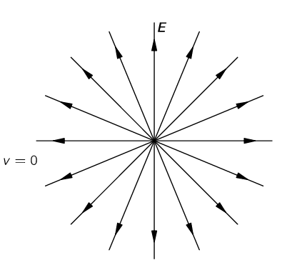
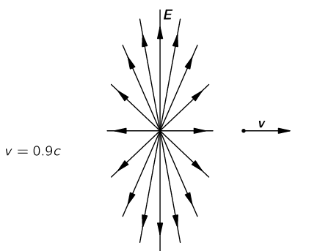

We start to consider what happens to the electric field when the charge (source of the E-field) is moving
It is interesting to note that there is a very easy way to remember the effect
of the transformation with the help of a thought experiment:
“Draw on a piece of paper the field lines for a charge at rest. Then set the picture to travelling with the speed v. The whole picture is compressed by the Lorentz contraction. The compressed picture represents the field lines of the moving charge.”
Careful consideration of the Lorentz transformations of the fields shows
$$B=\frac{\underline{v}×\underline{E}}{c^{2}}$$
Strictly speaking E should be the E-field of the moving charge from above!

Slide 3

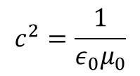


For a slow moving charge with v<<c (such as charge carriers moving in a metallic wire with drift velocity less than 1mm/s <<<<< c ) we can take E as seen from the co-moving frame.
This is just the ordinary Coulomb field of a stationary point charge
$$E=\frac{q}{4πε_{0}}\frac{\underline{r}}{r^{3}}$$
With
$$B=\frac{\underline{v}×\underline{E}}{c^{2}}$$
$$B=\frac{q}{4πε_{0}}\frac{\underline{v}×\underline{r}}{c^{2}r^{3}}$$
using
$$c^{2}=\frac{1}{ε_{0}μ_{0}}$$
Strictly speaking the above expression for the B-field is an approximation and therefore the Biot-Savart law based on it is an approximation.
However, because the drift velocity of electrons is so much lower than the speed of light, the approximation is extremely good, so good, that virtually no text ever mentions that it is an approximation.

