Slide 1
Bose-Einstein distribution function
Armed with
We calculate
Probability to find the state
in the grandcanonical ensemble
With ρ we can calculate thermal averages:

Slide 2
Again complete thermodynamics via potential
from Legendre transformation of Helmholtz free energy
alternative ways to derive using either ρ or φ
1
calculate
for Bose gas identifying average occupation #
with Bose-Einstein distribution
and
using
and

Slide 3
For non-interacting
bosons with
Bose-Einstein distribution function

Slide 4
As a crosscheck we show from
that in fact
With
Simplifying and using

Slide 5
2
Calculate thermal average using ρ
From

Slide 6
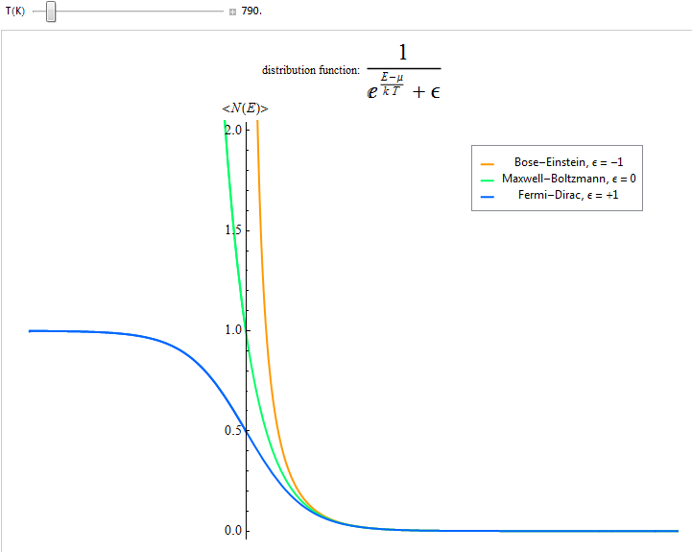
Visualizing & discussing the Bose-Einstein distribution function
Click here for on-line animation and downloadable live version& source code in Mathematica
Inspection of the summations in the partition functions show that convergence requires
If lowest single particle energy
chemical potential
We also see for N=const

Slide 7
Careful analysis (see text page 426) shows that for N=const the fraction N₀/N of bosons condensed into the lowest single-particle energy state has the T-dependence:
Bose-Einstein condensation
Phase transition setting at a
Critical temperature T_{c}
Examples (although with interaction):
Superconductivity
Superfluidity
The Bose-Einstein distribution function in the limit
such that
Boltzmann distribution
Let’s find the normalizing factor:
normalized Boltzmann factor

