Slide 1
Consequences from the Existence of Entropy
Relationship between the internal energy U=U(T,V) and the equation of state P=P(T,V)
Remember: with this notation
we separate inexact or potentially inexact
differentials from exact differentials
1/T is the
integrating factor
dS exact
=

Slide 2

Calculation of the derivatives yields
Obviously:
U=U(T,V)
and
P=P(T,V)
not independent
We show for the ideal gas:
1
is a consequence of U=U(T)
U=U(T)
From

Slide 3
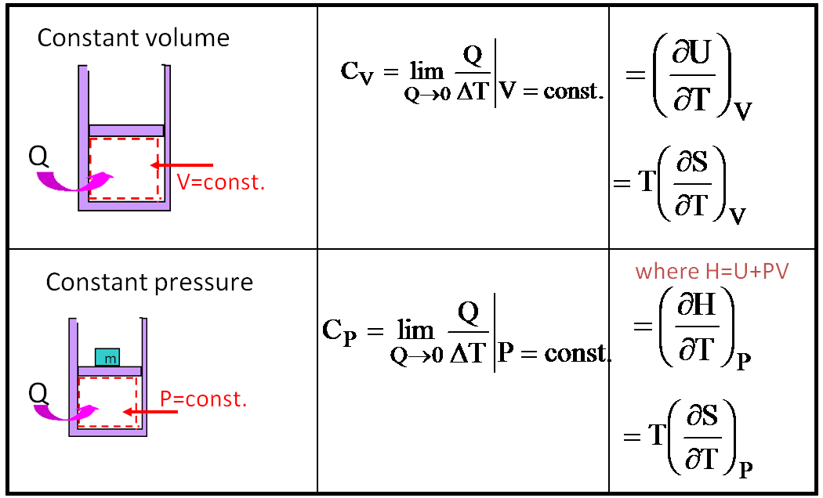
2
U=U(T)
is derived from
U independent of V
U=U(T)
Entropy of an ideal gas and isentropic processes
C_{V}
Reminder to heat capacity definition

Slide 4
for the ideal gas
in general
for the ideal gas
Comparison
(in order to obtain dimensionless argument of
the logarithm introduce a reference state (T_{r},V_{r}) )
(T,P)
Change from (T,V)
(P,V)
Easily done with
PV=nRT

Slide 5

Isentropic processes
Reversible adiabatic processes are isentropic processes that is, processes
in which the entropy is constant.
S=const.
Isentropic processes in ideal gases
isentropic

Slide 6

Example for relationship between material properties from existence of entropy
Consider
with
Remember:
with
derived from general considerations

