Slide 1
Electrons in metals
Jellium model:
Electron “sees” effective smeared potential
∞
∞
Energy E
electrons shield potential to a large
extent
Nucleus with
localized core
electrons
+
+
+
+
+
+
+
+
Spatial coordinate x

Slide 2
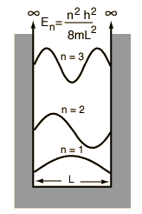
Electron in a box
In three dimensions:
In one dimension:
where
where
and

Slide 3
+
∞
+
+
+
+
+
+
+
+
+
+
+
+
x
0
L
+
+
+
Fixed boundary conditions:
Periodic boundary conditions:
“free electron parabola”
and
Remember the concept of
density of states
# of states
in
kx

Slide 4
1. approach
use the technique already applied for phonon density of states
where
Density of states per unit volume
Because I copy this part of the lecture from my solid state slides, I use E as the single particle energy.
In our stat. phys. lecture we labeled the single particle energy ε to distinguish it from the total energy of the N-particle system.
Please don’t be confused due to this inconsistency.

Slide 5
ky
1/ Volume occupied by a state in k-space
Volume( )
kx
kz

Slide 6
Independent from
ϑ and ϕ
Independent from
ϑ and ϕ
Free electron gas:
k²
dk
2
Each k-state can be occupied with 2 electrons of spin up/down

Slide 7
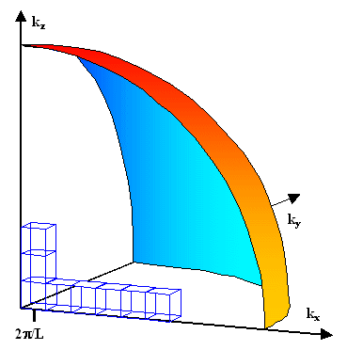
2. approach
calculate the volume in k-space enclosed by the spheres
and
ky
kx
# of states between spheres with k and k+dk :
2 spin states
with
2

Slide 8
D(E)
D(E)dE
=# of states in dE / Volume
E’
E’+dE
E

Slide 9
The Fermi gas at T=0
D(E)
f(E,T=0)
1
EF
E
EF⁰
E
Fermi energy
depends on T
#of states in [E,E+dE]/volume
Electron density
T=0
Probability that state is occupied

Slide 10
Energy of the electron gas:
Energy of the electron gas @ T=0:
there is an average energy of
per electron without thermal stimulation
with electron density
we obtain

Slide 11
only a few electrons in the vicinity of EF can be scattered by thermal energy
into free states
Specific heat much smaller than expected from classical consideration
Specific Heat of a Degenerate Electron Gas
here: strong deviation from classical value
energy of
electron
state
D(E)
#states in [E,E+dE]
Density of occupied states
probability of occupation,
average occupation #
2kBT
Before we calculate U let us estimate:
EF
E
These
# of electrons
increase energy from
to

Slide 12
π²
3
subsequent more precise calculation
Calculation of Cel from
Trick:
Significant contributions only in the vicinity of EF

Slide 13
D(E)
EF
E
with
and
decreases rapidly to zero for

Slide 14
with
and
in comparison with
for relevant temperatures
Heat capacity of a metal:
electronic contribution
lattice contribution
@ T<<ӨD
W.H. Lien and N.E. Phillips, Phys. Rev. 133, A1370 (1964)

