Slide 1
Ensemble equivalence
The problem of equivalence between canonical and microcanonical ensemble:
canonical ensemble contains systems of all energies. How come this leads to the same thermodynamics the microcanonical ensemble generates with fixed E ?
Heuristic consideration
= Probability of finding a system (copy) in the
canonical ensemble with energy in [E,E+dE]
example for monatomic ideal gas
example here with N=20, k_{B}T=1
example here with N=20, k_{B}T=1
In the thermodynamic limit N→∞
overwhelming majority of systems in the canonical ensemble has energy U= <E>

Slide 2
Next we show:
and
is a general, model independent result
Brief excursion into the theory of fluctuations
Measure of: average deviation of the random variable X from its average values <X>
From the definition of <f(x)> as:
We obtain:

Slide 3
Energy fluctuations
Goal:
find a general expression for
We start from:
of the canonical ensemble

Slide 4
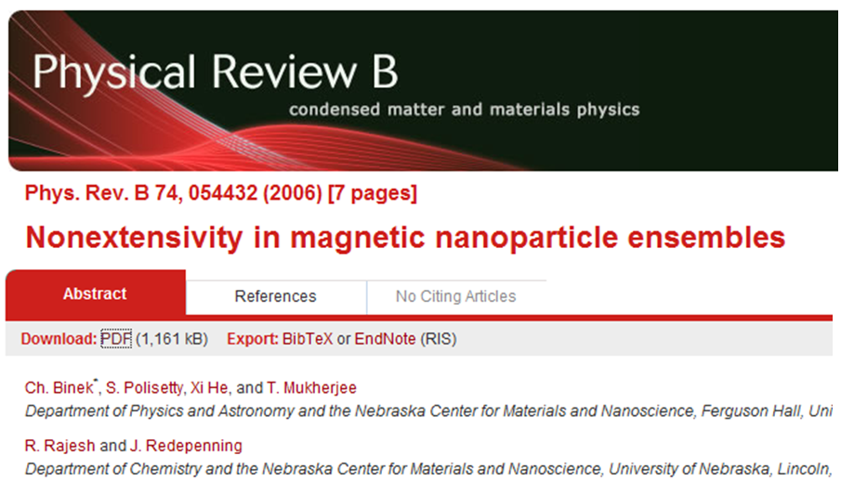
U and C_{V} are extensive quantities
and
and
As N→∞ almost all systems in the canonical ensemble
have the energy E=<E>=U
Having that said there are
exceptions and ensemble equivalence
can be violated as a result

Slide 5
An eye-opening numerical example
Let’s consider a monatomic ideal gas for simplicity in the classical limit
We ask:
What is the uncertainty of the internal energy U, or how much does U fluctuate?
For a system in equilibrium in contact with a heat reservoir
U fluctuates around <E> according to
With the general result
For the monatomic ideal gas with
and
For a macroscopic system with
Energy fluctuations are
completely insignificant

Slide 6
Equivalence of the grand canonical ensemble with fixed particle ensembles
We follow the same logical path by showing:
particle number fluctuations in equilibrium become insignificant in the thermodynamic limit
remember fugacity
We start from:
With
we see

Slide 7
Remember:
With
With

Slide 8
With
and again
Using the definition of the isothermal compressibility
Particle fluctuations are
completely insignificant in the
thermodynamic limit

