Slide 1
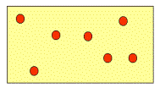
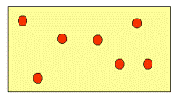
Open systems &
The grand canonical ensemble
Open system
Particle exchange with the surrounding (particle reservoir) allowed
e.g., a surface of a solid exchanging particles with a gas
V=const
Particle reservoir
Heat Reservoir R
T=const.
Thermodynamic potentials depend on variable particle number N

Slide 2
Microcanonical ensemble
Canonical ensemble
Grand canonical ensemble
E fixed
average energy
average energy
constraint
average
particle number

Slide 3
Deriving density function ρ and partition function Z_{G}
of the grand canonical ensemble
with
Partition function of the
grand canonical ensemble
Next we show
where
is the chemical potential
From the constraint

Slide 4
U
N
1
With

Slide 5
Expressing Z_{G} with the help of N-particle canonical partition functions
Sum over all states of 1 particle
Sum over all states of 2 particle
fugacity

Slide 6
Ideal gases considered in the grand canonical ensemble
We saw previously
Remember canonical partition
of ideal gas of fixed N particles

Slide 7
With

