Slide 1





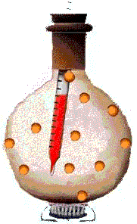
Statistical physics
Introductory remarks
Thermodynamics
Thermal Physics
kinetic theory
statistical mechanics
Aim of statistical mechanics:
gas
liquid
solid
magnet
Electromag.
radiation
Derive all equilibrium properties of a macroscopic molecular system
from the laws of molecular dynamics:

Slide 2

expansion coefficient
e.g.
Derive
-the general laws of thermodynamics
and
-the specific thermodynamic functions
from “first principles”.
Heat capacity at
constant
pressure/volume
compressibility
e.g.
be aware of the presence of “dirty little secrets” with fancy names (such as ergodic hypothesis).
Note:
Statistical mechanics is not superior to thermodynamics.
E.g., the second law cannot be derived without ad hoc assumptions.
We will achieve a connection between
the microphysics and thermodynamics via statistics

Slide 3
Brief reminder to thermodynamics*
*by no means complete, for details see literature and http://physics.unl.edu/~cbinek/Teaching.htm
Thermodynamics: Macroscopic theory of thermal properties of matter
based on a small number of principles which are generalizations of experimental experiences
is consistent (axiomatic theory) but not fundamental
Starting from the laws of thermodynamics (0th,1th , 2nd , 3rd )
a consistent theory can be developed
Theory of great generality

Slide 4

Zeroth law of thermodynamics:
When any two systems are each separately in thermal equilibrium
with a third, they are also in thermal equilibrium with each other.
foundation of temperature measurement
Thermodynamic System:
Certain portion of the
universe with a boundary
System Σ₃
(e.g. thermometer)
System Σ₁
System Σ₂

Slide 5
First law of thermodynamics:
All systems have an internal energy state function, U, that is changed
by heat, Q, transferred to or from the system and by the work, W,
done by or on the system.
conservation of energy
closed system
internal energy
state function
Σ
Energy transferred by
macroscopic mechanical
means
Energy transferred by
non-macroscopic mechanical
means
Σ_{Q}
Σ_{A}

Slide 6
Work:
First Law of Thermodynamics
Total energy transferred to a system by macroscopic forces
exerted on it by other systems
Work
done by a gas on a piston
A
Work done by a fluid as it expands
from V₀ to V_{f}
Fluid (gas)
F
=P A
0
Δx
x
Work done by the system
A
Work done on the system
Δx
Note: sign convention for W varies for various textbooks,
however, ,holds always

Slide 7


Heat
T₁
>
T₂
System Σ₁
System Σ₂
Heat Q flows from
Σ₁ to Σ₂
Heat is an energy transferred from one system to another because of temperature difference
Σ_{1/2}
and not a state function
Heat is not part of the systems
Do not confuse heat with the internal energy of a system

Slide 8

Sign Convention
Heat Q is measured with respect to the system
System
Q>0
Heat flow into the system
Q>0
System
Q<0
Heat flow out of the system

Slide 9
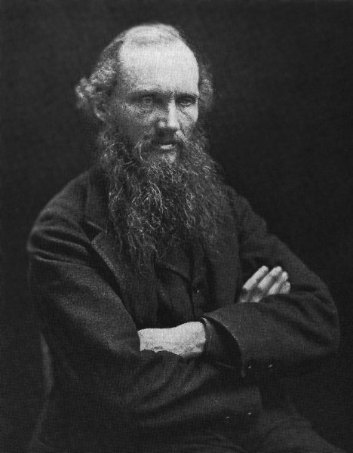
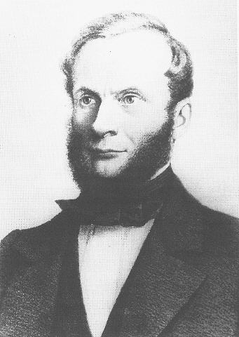
Second Law of Thermodynamics
1st and 2nd laws are fundamental unifying principles of thermodynamics
Restrictions on the energy transfer
Energy is conserved
Internal energy, U, is a state function
Heat is a form of energy transfer
Kelvin statement of the second law:
There is no process whose only effect is to
accept heat from a single heat reservoir and
transform it entirely into work.
Lord Kelvin
(William Thomson)
(1824-1907)
Hypothetical devices violating the 2nd Law
Clausius statement of the second law:
There is no process whose only effect is to accept heat
from a colder reservoir and transfer it to a hotter one.
Rudolf Clausius
(2.1.1822 -24.8.1888)

Slide 10
Entropy statement of the second law:
The total entropy of an adiabatically isolated system never decreases.
Entropy:
P
In a reversible cyclic process we find
The following 4 statements imply each other
1
dA is the differential of a function
2
dA is exact
3
for all closed contours
4
Independent of the line connecting
V
is an exact differential
dS is the differential of a state function called entropy S.

