Slide 1
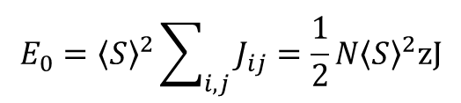

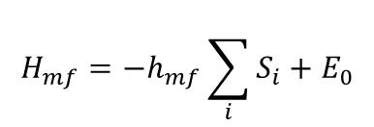


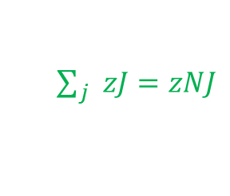
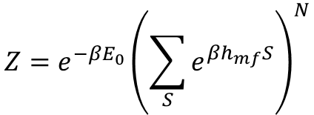
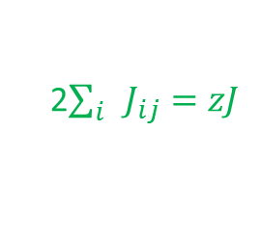
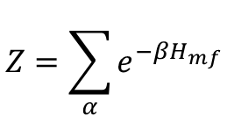

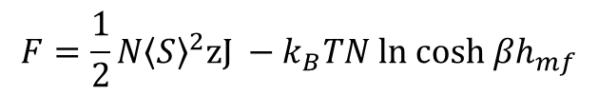
Landau Theory
Before we consider Landau’s expansion of the Helmholtz free Energy, F, in terms of an order parameter,
let’s consider F derived from the mean-field Hamiltonian
$$H_{mf}=−h_{mf}\sum_{i}{S_{i}}+E_{0}$$
$$E_{0}={\left\langle S\right\rangle }^{2}\sum_{i,j}{J_{ij}}=\frac{1}{2}N{\left\langle S\right\rangle }^{2}zJ$$
with
$$h_{mf}=h+\left\langle S\right\rangle zJ$$
and
2$\sum_{i}{J_{ij}=zJ}$
We call the molecular field now, h_{mf}, to avoid confusion with
the order parameter introduced in Landau theory
$\sum_{j}{zJ=zNJ}$
$$Z=\sum_{α}{e^{−βH_{mf}}}$$
$$Z={e^{−βE_{0}}\left(\sum_{S}{e^{βh_{mf}S}}\right)}^{N}$$
With H_{mf} we calculate
For an Ising system with
$$S=±1$$
$$Z={e^{−βE_{0}}\left(2cosh βh_{mf}\right)}^{N}$$
$$F=F\left(T,\left\langle S\right\rangle \right)=−k_{B}T lnZ$$
$$F=\frac{1}{2}N{\left\langle S\right\rangle }^{2}zJ −k_{B}TN ln cosh βh_{mf}$$
Note that h_{mf} depends on magnetization/$\left\langle S\right\rangle$

Slide 2
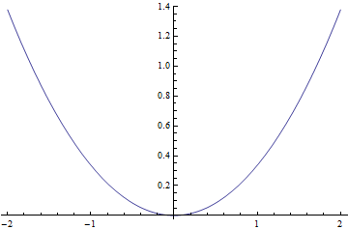
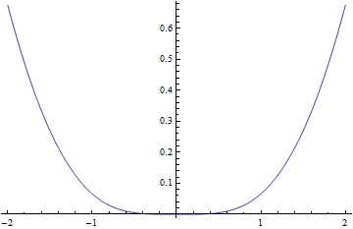
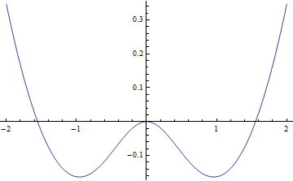

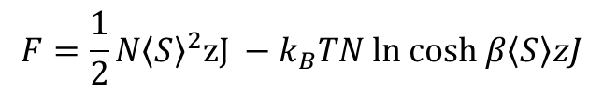

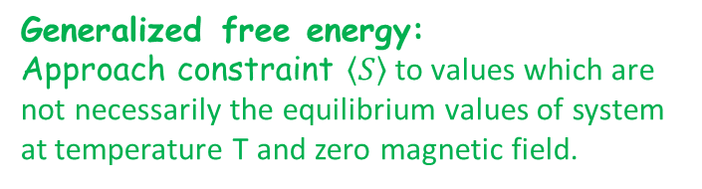

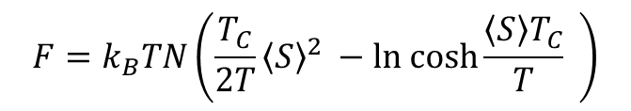
For the simple case h=0 this yields
$$F=\frac{1}{2}N{\left\langle S\right\rangle }^{2}zJ −k_{B}TN ln cosh β\left\langle S\right\rangle zJ$$
Generalized free energy:
Approach constraint $\left\langle S\right\rangle$ to values which are not necessarily the equilibrium values of system at temperature T and zero magnetic field.
$$F=k_{B}TN\left(\frac{T_{C}}{2T}{\left\langle S\right\rangle }^{2} −ln cosh\frac{\left\langle S\right\rangle T_{C}}{T} \right)$$
How do we find equilibrium $\left\langle S\right\rangle$ from generalized free energy ?
Minima of F for T>T_{C} and T<TC
T=3T_{C}
F
T=T_{C}
T=T_{C} /2
F
F
$$\left\langle S\right\rangle$$
$$\left\langle S\right\rangle$$
$$\left\langle S\right\rangle$$

Slide 3


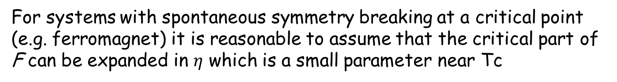


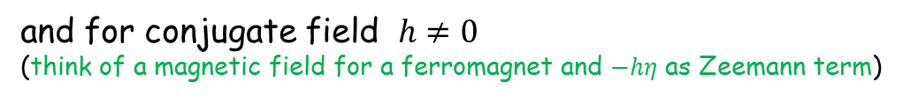
Relation to Landau Theory
Landau introduced the concept of an order parameter η
(e.g., magnetization for a ferromagnet, density difference for a liquid-vapor transition, …) with the properties
$$η=0$$
for T>T_{C}
$$η≠0$$
for T<T_{C}
For systems with spontaneous symmetry breaking at a critical point
(e.g. ferromagnet) it is reasonable to assume that the critical part of
F can be expanded in $η$ which is a small parameter near Tc
Demanding time inversion symmetry for F and considering $η\left(−t\right)=−η(t)$
Only even powers if $η$ symmetry allowed in h=0
$$F=\frac{1}{2}aη^{2}+\frac{1}{4}bη^{4}+…$$
and for conjugate field $h≠0$
(think of a magnetic field for a ferromagnet and $−hη$ as Zeemann term)
$$F=\frac{1}{2}aη^{2}+\frac{1}{4}bη^{4}−hη$$

Slide 4


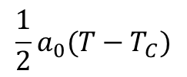



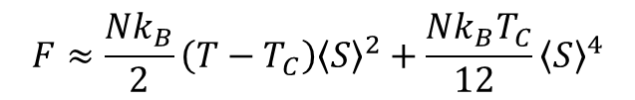
In order to reproduce the symmetry breaking at T_{C} simplest ansatz
$$a$$
changes sign at T_{C} according
$$a=a_{0}(T−T_{C})$$
$$b>0$$
for stability
$$F=\frac{1}{2}a_{0}(T−T_{C})η^{2}+\frac{1}{4}bη^{4}−hη$$
It turns out that this is in good approximation the F we obtain from the mean field expression
To show that, let’s expand F(T, $\left\langle S\right\rangle$) for h=0 around $\left\langle S\right\rangle ≈0$
$$F=k_{B}TN\left(\frac{T_{C}}{2T}{\left\langle S\right\rangle }^{2} −ln cosh\frac{\left\langle S\right\rangle T_{C}}{T} \right)≈\frac{Nk_{B}T_{C}}{2}\left(1−\frac{T_{C}}{T}\right){\left\langle S\right\rangle }^{2}+\frac{Nk_{B}T_{C}^{4}}{12 T^{3}}{\left\langle S\right\rangle }^{4}+…$$
which can be approximated further using into $T≈T_{C}$
$$F≈\frac{Nk_{B}}{2}\left(T−T_{C}\right){\left\langle S\right\rangle }^{2}+\frac{Nk_{B}T_{C}}{12 }{\left\langle S\right\rangle }^{4}$$
Landau and mean-field theory
give identical thermodynamics
for T->T_{C} (equally wrong!)
$$\frac{1}{2}a_{0}(T−T_{C})$$
$$\frac{1}{4}b$$

Slide 5


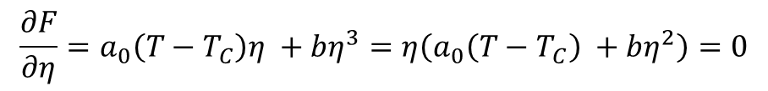




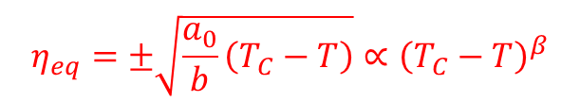


Let’s enjoy the simplicity of the Landau free energy expression to derive
the T-dependence of $η,$ $χ$,and heat capacity c
(there is more to calculate such as correlation length and h-dependence of $η$ )
$η_{eq}$in zero conjugate field:
$$F=\frac{1}{2}a_{0}(T−T_{C})η^{2}+\frac{1}{4}bη^{4}$$
Equilibrium condition
$$\frac{∂F}{∂η}=0$$
$$\frac{∂F}{∂η}=a_{0}\left(T−T_{C}\right)η +bη^{3}=η\left(a_{0}\left(T−T_{C}\right) +bη^{2}\right)=0$$
$$η_{eq}=±\sqrt{\frac{a_{0}}{b}\left(T_{C}−T\right)}∝{\left(T_{C}−T\right)}^{β}$$
with β=1/2
$$η_{eq}=0$$
$$⋁$$
F
T<T_{C}
F
Critical exponent
T>T_{C}
$$η$$
$$η$$

Slide 6








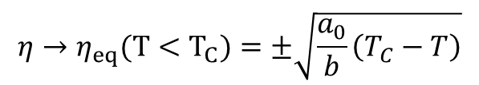

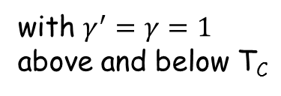


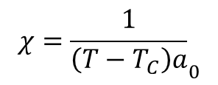

Susceptibility $χ\left(T\right)=\frac{∂η}{∂h}$
$$F=\frac{1}{2}a_{0}(T−T_{C})η^{2}+\frac{1}{4}bη^{4}−hη$$
Equilibrium condition
$$\frac{∂F}{∂η}=0$$
equation of state
$$h=a_{0}\left(T−T_{C}\right)η +bη^{3}$$
Implicit differentiation:
$χ\left(T\right)$ for T>T_{C}
h->0
$$η_{eq}→0$$
$$χ={\frac{1}{\left(T−T_{C}\right)a}}_{0}$$
$$1=a_{0}\left(T−T_{C}\right)χ$$
for T>T_{C}
$${η→η}_{eq}(T<T_{C})=±\sqrt{\frac{a_{0}}{b}\left(T_{C}−T\right)}$$
$χ\left(T\right)$ for T<T_{C}
h->0
$$1=a_{0}\left(T−T_{C}\right)χ +3bχ\frac{a_{0}}{b}\left(T_{C}−T\right)$$
$$1={−a}_{0}\left(T_{C}−T\right)χ+3a_{0}χ\left(T_{C}−T\right)$$
$$χ={\frac{1}{2\left(T_{C}−T\right)a}}_{0}$$
for T<T_{C}
$$χ∝{\left|T−T_{C}\right|}^{−γ′}$$
with $γ^{′}=γ=1$
above and below T_{C}
Note factor 2 here.
It is also not obvious that critical exponents are identical.

Slide 7






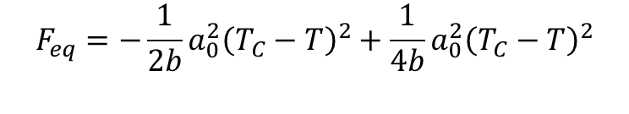

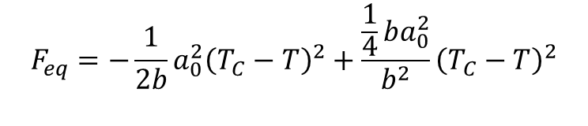

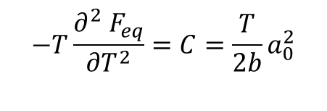
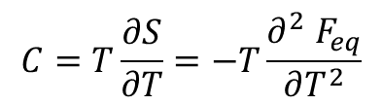


Specific heat C in zero conjugate field
From thermodynamics we remember
$$S=−\frac{∂ F_{eq}}{∂T}$$
$$C=T\frac{∂S}{∂T}=−T\frac{∂^{2} F_{eq}}{∂T^{2}}$$
For T<T_{C} we obtain for the equilibrium free energy
$$F_{eq}=−\frac{1}{2b}a_{0}^{2}{\left(T_{C}−T\right)}^{2}+\frac{\frac{1}{4}ba_{0}^{2}}{b^{2}}{\left(T_{C}−T\right)}^{2}$$
$$F_{eq}=\frac{1}{2}a_{0}(T−T_{C})η_{eq}^{2}+\frac{1}{4}bη_{eq}^{4}$$
$$F_{eq}=−\frac{1}{2b}a_{0}^{2}{\left(T_{C}−T\right)}^{2}+\frac{1}{4b}a_{0}^{2}{\left(T_{C}−T\right)}^{2}$$
$$F_{eq}=−\frac{1}{4b}a_{0}^{2}{\left(T_{C}−T\right)}^{2}$$
$$\frac{∂ F_{eq}}{∂T}=\frac{1}{2b}a_{0}^{2}{\left(T_{C}−T\right)}^{}$$
$$\frac{∂^{2}{ F}_{eq}}{∂T^{2}}=−\frac{1}{2b}a_{0}^{2}$$
$$−T\frac{∂^{2} F_{eq}}{∂T^{2}}=C=\frac{T}{2b}a_{0}^{2}$$
$$C$$
for T<T_{C}
$${C∝\left(T−T_{C}\right)}^{−α}$$
For T>T_{C}
with
$α=0$
$$F_{eq}=0$$
$$C=0$$
for T>T_{C}
1
T/T_{C}

Slide 8






Critical exponents fall into universality classes
(they do not depend on microscopic details)
Critical exponents follow so called scaling relations
Relations can be derived:
-when imposing that F near T_{C} is a generalized homogeneous function (Widom) plausible from self-similarity of critical fluctuations (Kadanoff)
-via renormalization group theory (Wilson, Nobel prize 1982)
Mean-field and Landau get criticality equally wrong in 1, 2 and 3 spatial dimensions (criticality correct in 4 dimensions)
Nevertheless, relation which does not contain dimension is fulfilled by
Landau/mean-field critical exponents
$$2−α=2β+γ$$
(Rushbrooke’s identity)
$α=0$
$β$=1/2
$γ=1$
$$2−0=\frac{2}{2}+1$$

