Slide 1
Quantum statistics of free particles
Identical particles
Two particles are said to be identical if all their intrinsic properties (e.g. mass, electrical charge, spin, color, . . . ) are exactly the same.
Imagine: 2 identical classical objects
We can label them because
we can keep track of the trajectories
1
2
Heisenberg’s uncertainty principle prevents us from keeping track in qm
identical quantum particles are indistinguishable

Slide 2
Implications from indistinguishability
Consider Hamilton operator
,e.g.,
With corresponding Schroedinger eq.
For the interaction free situation considered here
spin variable
look at solutions of
i labels set of quantum numbers of particular single particle
eigenfunction (do not confuse with particle label)
for basis functions appropriate to build up
Why is a simple product ansatz not appropriate?
If we conduct an experiment with indistinguishable particles a correct quantum description cannot allow anything which distinguishes between them.

Slide 3

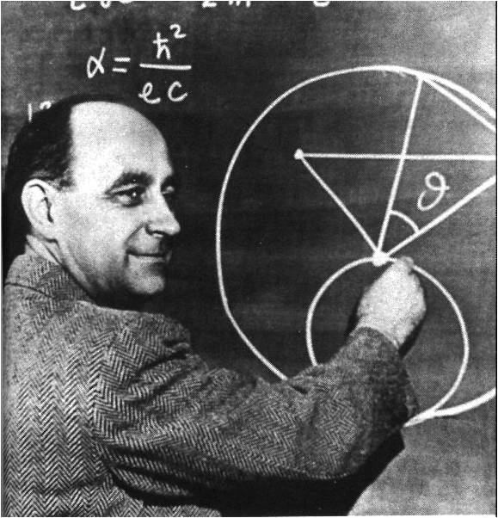
artificially distinguishes between the 2 particles
because indistinguishability requires
however in general
Simple product ansatz introduces unphysical labels to indistinguishable particles
What we need is a property like this
to fulfill
Nature picks to simple realizations for
bosons
fermions

Slide 4
These symmetry requirements regarding particle exchange are fulfilled by
bosons
fermions
Let’s summarize properties of antisymmetry product ansatz for fermions
1
Solves Schroedinger equations for non-interacting particles
2
Eigenenergies E_{α} are given by
3
Antisymmetry of wave function
4
Pauli principle fulfilled: for identical single particle quantum numbers
2 identical fermions cannot occupy the same single particle state

Slide 5
Antisymmetric wave function for N identical fermions
Slater determinant
Check N=2

Slide 6
Using occupation numbers to characterize N-particle states
Let n_{i} be the # indicating how often the single particle state ϕ_{i} is occupied
within the N-particle state described by ψ
fermions
only possibility in accordance with Pauli principle
bosons
A few examples:
N=2 particles
bosons
fermions

Slide 7
Summary occupation number representation:
1
2
N-particle state characterized by set of occupation numbers of single particle states
3
fermions
4
i labels set of single particle quantum numbers
bosons
Partition functions with occupation numbers
Partition function of the canonical ensemble

Slide 8
Partition function of the grandcanonical ensemble
We use the grandcanonical ensemble to derive <n_{i}>
the average occupation of the single particle state i
Let’s consider how the summation works for an example of N=0,1,2,3 fermions
N=0
(0,0,0) meaning all single particle states are unoccupied
N=1
(1,0,0) (0,1,0) (0,0,1)
N=2
(1,1,0) (0,1,1) (1,0,1)
N=3
(1,1,1)

Slide 9
Next we show
independent summation
over the n_{i}
Let’s first look at
and do a summation over n₁

Slide 10
Now summation over n₁ and n₂
And finally summation over n₁ , n₂ and n₃
Compare with

Slide 11
Holds for fermions and bosons with the only obvious difference
fermions
bosons

