Slide 1
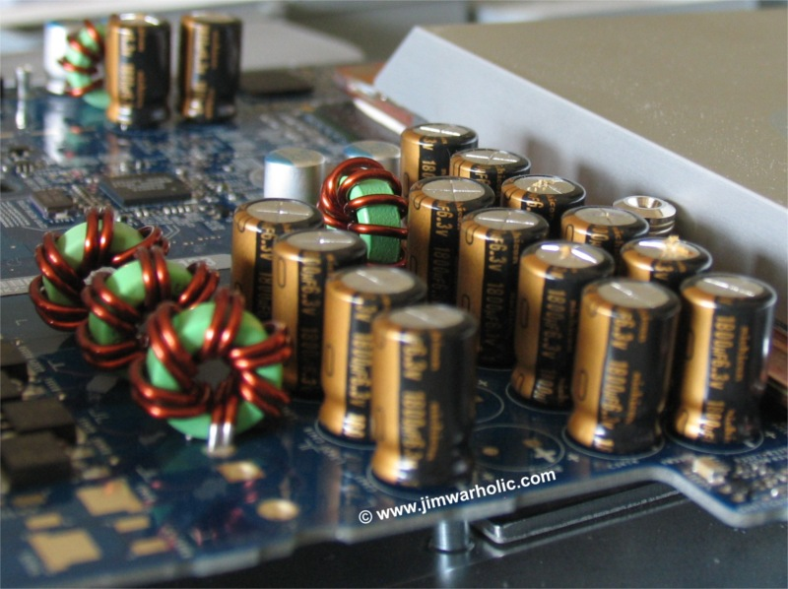
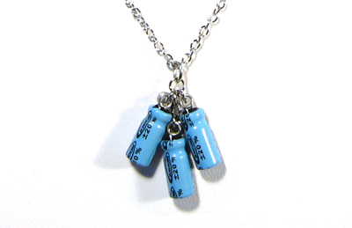
Capacitance IN Series and Parallel
Capacitors are manufactured with certain standard capacitances
Is there a way to obtain specific value of capacitance
Capacitors IN Series and Parallel

Slide 2
Capacitance IN Series
a
+Q
+ + + +
-Q
C₁
V_{ac}=V₁
- - - -
V_{ab}=V
c
+Q
+ + + +
C₂
V_{cb}=V₂
-Q
- - - -
b

Slide 3
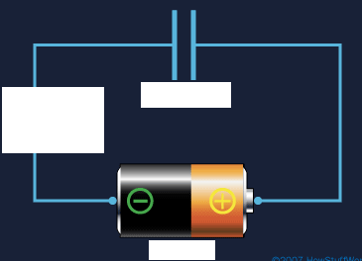
The combination can be replaced by a equivalent capacitance C_{eq}
+ + + +
+Q
C_{eq}
V
-Q
- - - -
In general for any number of capacitors in Series
Note: Magnitude of charge on each capacitor is the same, however potential difference can be different
V=V₁+V₂+V₃+ …

Slide 4
Capacitance IN Parallel
a
+ + + +
+ + + +
C₁
Q₁
C₂
Q₂
V_{ab}=V
- - - -
- - - -
b
The charges are
+ + + +
C_{eq}
Q=Q₁+Q₂
- - - -
In general for any number of capacitors in parallel

Slide 5
Intuitive understanding
Using the plate capacitor formula we derive the equivalent capacitance intuitively
Parallel plate capacitor
$$C=\frac{Aε_{0}}{d}$$
Two identical plate capacitors in series means effectively increasing the d
+Q
-Q
+Q
-Q
d
equipotential
d
+Q
-Q
$$\frac{1}{C_{eq}}=\frac{2d}{Aε_{0}}=\frac{1}{C}+\frac{1}{C}$$
d
d

Slide 6
Intuitive understanding
Two identical plate capacitors in parallel means effectively
increasing A in
$$C=\frac{Aε_{0}}{d}$$
+Q
-Q
+Q
-Q
d
d
A
A
equipotential
A
A
+Q
-Q
+Q
-Q
d
d
$$C_{eq}=\frac{2Aε_{0}}{d}=C+C$$

Slide 7
Clicker Question
The three configurations shown below are constructed using identical capacitors. Which of these configurations has lowest total capacitance?
A
B
C
C
C
C
C
C
C_{total} = C
1/C_{total} = 1/C + 1/C
C_{total} = 2C
= 2/C
C_{total} = C/2

Slide 8
Example
C2
C1
V
C3
(a)Determine the equivalent capacitance of the circuit shown if C₁ = C₂ = 2C₃ = 12.5 μF.
(b) How much charge is stored on each capacitor when V = 45.0 V?
Middle Branch: 1/C_{eq} = 1/C₂ + 1/C₃ → 1/C_{eq} = 1/12.5 μF + 1/6.25 μF → C_{eq} = 4.16667 μF
Combine parallel: C = C₁ + C_{eq} → C = 12.5 μF + 4.1666667 μF = 16.6667 μF
Voltage over each parallel branch is same as the battery:
C₁: 45.0 V Q₁=C₁V= 12.5 μF 45V= 562.5μC
C_{eq}: 45.0 V
Series: V=V₂ + V₃ = q/C₂ + q/C₃ = q/C_{eq} → q = C_{eq}V → q = (4.166667 μF)(45V)= 187.5μC
C₂: V = q/C = 187.5 μ C/12.5 μF = 15 V
C₃: V = 187.5 μ C/6.25 μF = 30 V
Check result: V=V₂ + V₃=15V+30V=45V

Slide 9
Energy storage in Capacitors
-Q
+Q
At an intermediate time (t<t_{charged})
V=V_{a}-V_{b}
q is the charge
v is the potential difference
Work dW required to transfer an additional charge dq
V_{b}
V_{a}
The total work W required to increase capacitor charge from 0 to Q
We define potential energy of an uncharged capacitor to be zero then W is equal to potential energy U
Notes:
W is the work done by E on Q. q decreases from a initial value Q to 0 as elements of charge dq fall through potential difference v that vary from V to 0

Slide 10
Electric field energy
We derived the various forms of electric potential energy stored in a capacitor
If we think about charging a capacitor by
moving charge from one plate to the
other that requires work against the electric field
We can think of the energy being stored in the electric field
With
$$U=\frac{1}{2}CV^{2}$$
we can introduce the energy density
$$u=\frac{U}{Ad}=\frac{CV^{2}}{2Ad}$$
Using the parallel plate capacitor expressions
$$V=Ed$$
and
$$C=\frac{Aε_{0}}{d}$$
$$u=\frac{Aε_{0}E^{2}d^{2}}{2Ad^{2}}=\frac{1}{2}ε_{0}E^{2}$$
Vacuum is not truly
empty space but
can have energy
energy density

