Slide 1



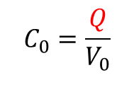
Dielectrics
Experiment: Place dielectrics between
plates of capacitor at
Q=const condition
Observation: potential difference decreases to smaller value with
dielectric material relative to air
Without dielectric:
$$C_{0}=\frac{Q}{V_{0}}$$
$$Q=const$$
because V<V₀
C>C₀
With dielectric:
$$C=\frac{Q}{V}$$
$$Κ:=\frac{C}{C_{0}}=\frac{V_{0}}{V}$$
K>1: relative dielectric constant

Slide 2

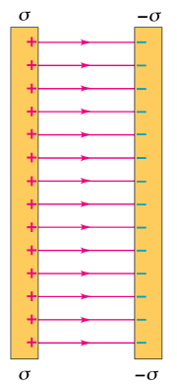
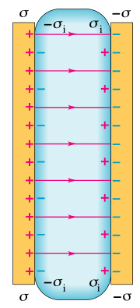







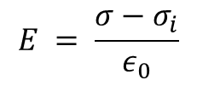

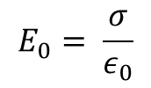

What happens with the E-field in the presence of dielectric material
$$Q=const$$
We know V<V₀
E<E₀
specifically
$$Κ=\frac{V_{0}}{V}=\frac{E_{0}}{E}$$
$$E=\frac{E_{0}}{Κ}$$
d
Recall: $E= \frac{σ_{net}}{ε_{0}}$
$$σ_{net}$$
reduced with dielectric material
The surface charge (density) σ on conducting plates does not change but
induced charge σ_{i} of opposite sign
$$E_{0}= \frac{σ}{ε_{0}}$$
and
$$E = \frac{σ−σ_{i}}{ε_{0}}$$
$$σ_{i}=σ(1−\frac{1}{K})$$
$$E= \frac{σ}{{Kε}_{0}}$$
Definition of the permittivity
$$ε=Kε_{0}$$
$C=ε\frac{A}{d}$ and $u=\frac{1}{2}εE^{2}$

Slide 3
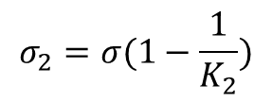
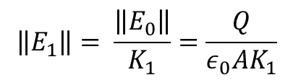
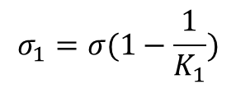
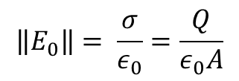
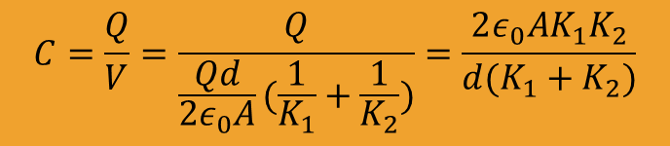
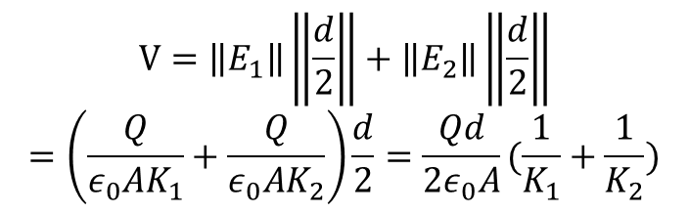
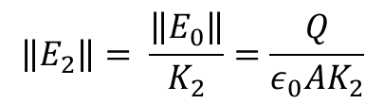
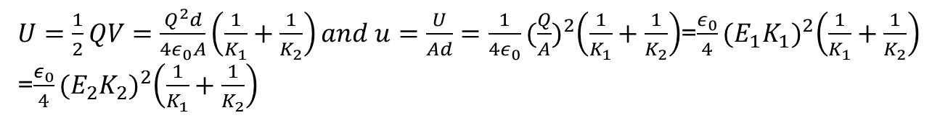
Dielectrics
+Q
Example:
E₁
d/2
E₀
K₁
V
E₂
K₂
d/2
-Q
$$\left\|E_{0}\right\|= \frac{σ}{ε_{0}}=\frac{Q}{ε_{0}A}$$
$$V=\left\|E_{1}\right\|\left\|\frac{d}{2}\right\|+\left\|E_{2}\right\|\left\|\frac{d}{2}\right\|$$
$$=\left(\frac{Q}{ε_{0}AK_{1}}+\frac{Q}{ε_{0}AK_{2}}\right)\frac{d}{2}=\frac{Qd}{2ε_{0}A}(\frac{1}{K_{1}}+\frac{1}{K_{2}})$$
$$\left\|E_{1}\right\|= \frac{\left\|E_{0}\right\|}{K_{1}}=\frac{Q}{ε_{0}AK_{1}}$$
$$\left\|E_{2}\right\|= \frac{\left\|E_{0}\right\|}{K_{2}}=\frac{Q}{ε_{0}AK_{2}}$$
$$C=\frac{Q}{V}=\frac{Q}{\frac{Qd}{2ε_{0}A}(\frac{1}{K_{1}}+\frac{1}{K_{2}})}=\frac{2ε_{0}AK_{1}K_{2}}{d(K_{1}+K_{2})}$$
$$σ_{1}=σ(1−\frac{1}{K_{1}})$$
$$σ_{2}=σ(1−\frac{1}{K_{2}})$$
$U=\frac{1}{2}QV=\frac{Q^{2}d}{4ε_{0}A}\left(\frac{1}{K_{1}}+\frac{1}{K_{2}}\right)and u=\frac{U}{Ad}=\frac{1}{4ε_{0}}{(\frac{Q}{A})}^{2}\left(\frac{1}{K_{1}}+\frac{1}{K_{2}}\right)$=$\frac{ε_{0}}{4}{(E_{1}K_{1})}^{2}\left(\frac{1}{K_{1}}+\frac{1}{K_{2}}\right)$
=$\frac{ε_{0}}{4}{(E_{2}K_{2})}^{2}\left(\frac{1}{K_{1}}+\frac{1}{K_{2}}\right)$

Slide 4
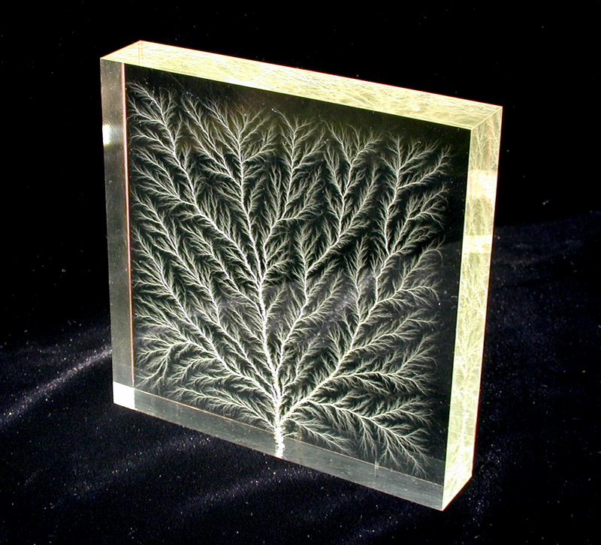
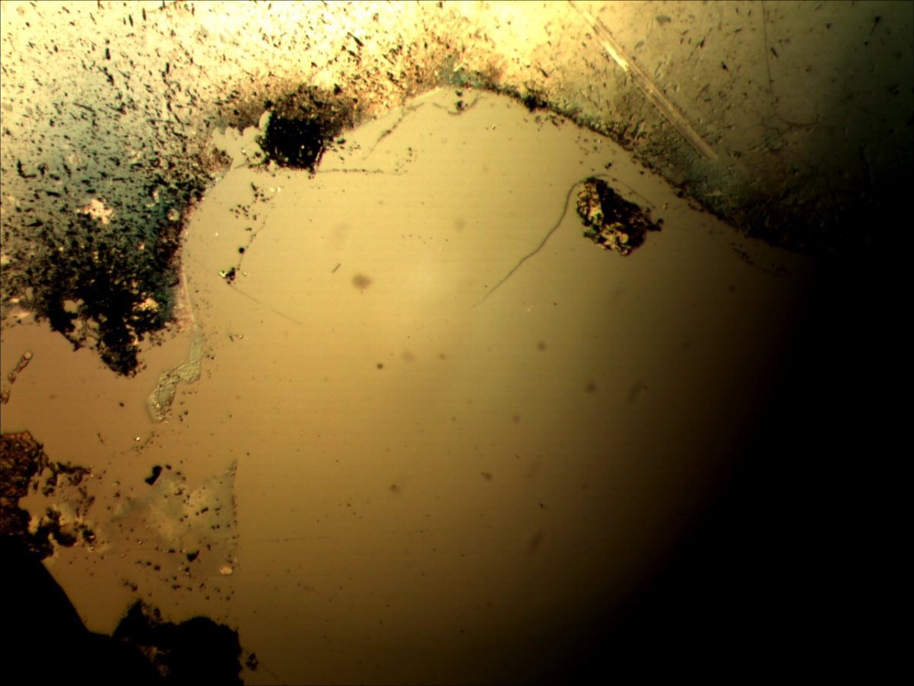
24.4 Dielectrics
High Voltage
Dielectric breakdown or Dielectric strength
Ground
Cr₂O₃
Ground
Air

Slide 5
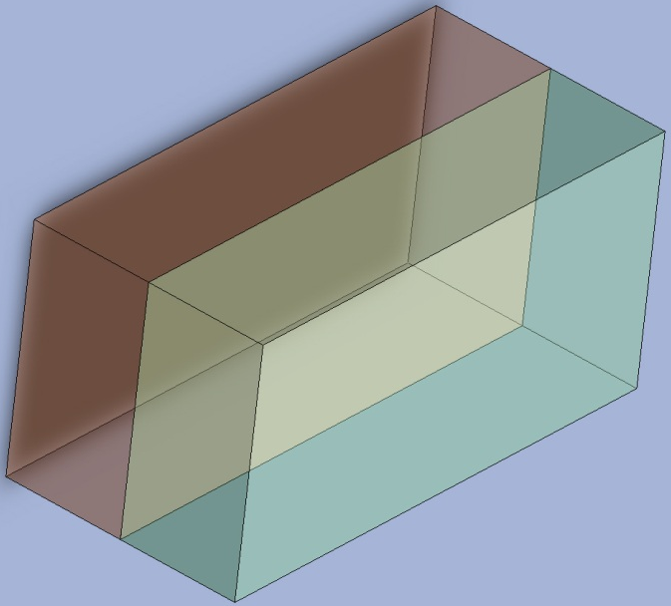
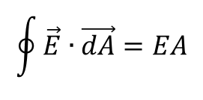
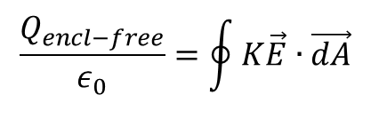


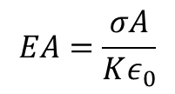
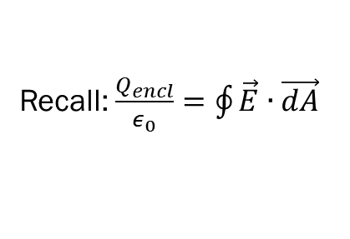

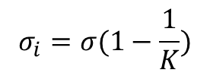

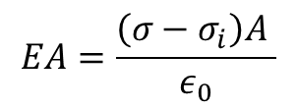

Gauss’s Law in Dielectrics
Recall: $\frac{Q_{encl}}{ε_{0}}=\oint{\vec{E}∙\vec{dA}}$
$$Q_{encl}=\left(σ−σ_{i}\right)A$$
$$\vec{E}=0$$
$$\vec{E}≠0$$
$$\oint{\vec{E}∙\vec{dA}=EA}$$
Conductor
Dielectrics
$$EA=\frac{\left(σ−σ_{i}\right)A }{ε_{0}}$$
$$σ_{i}=σ(1−\frac{1}{K})$$
$$σ$$
$${−σ}_{i}$$
$$EA=\frac{σA}{Kε_{0}}$$
$$\frac{Q_{encl−free}}{ε_{0}}=\oint{K\vec{E}∙\vec{dA}}$$
A
A
A

Slide 6
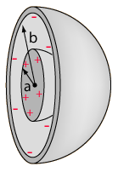
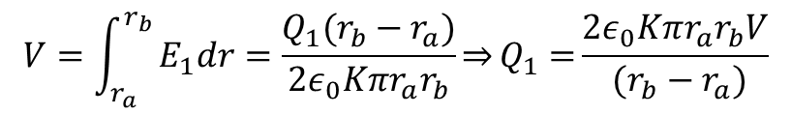

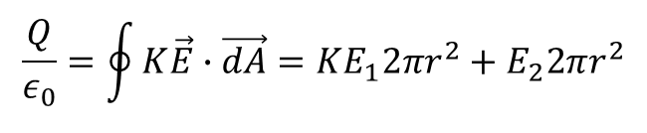
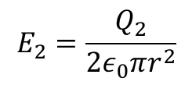
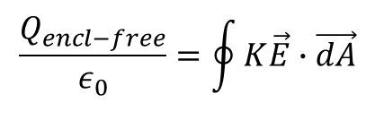
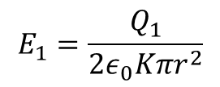
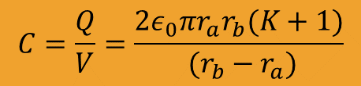

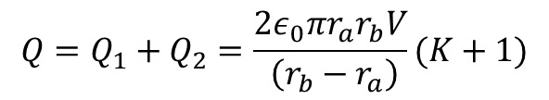

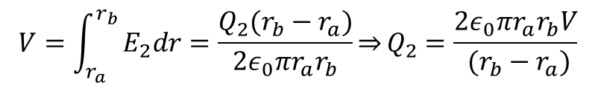
Gauss’s Law in Dielectrics
Example:
Capacitance of half filled spherical capacitor
$$\frac{Q_{encl−free}}{ε_{0}}=\oint{K\vec{E}∙\vec{dA}}$$
K
E₁
$$\frac{Q}{ε_{0}}=\oint{K\vec{E}∙\vec{dA}}=KE_{1}2πr^{2}+E_{2}2πr^{2}$$
r_{a}
$$\frac{Q_{1}}{ε_{0}}$$
$$\frac{Q_{2}}{ε_{0}}$$
r
r_{b}
E₂
$$E_{1}=\frac{Q_{1}}{{2ε}_{0}Kπr^{2}}$$
$$E_{2}=\frac{Q_{2}}{{2ε}_{0}πr^{2}}$$
$$V=\int_{r_{a}}^{r_{b}}{E_{1}dr=\frac{Q_{1}(r_{b}−r_{a})}{{2ε}_{0}Kπr_{a}r_{b}}\underset{⇒}{}Q_{1}=}\frac{{2ε}_{0}Kπr_{a}r_{b}V}{ (r_{b}−r_{a})}$$
$$Q=Q_{1}+Q_{2}=\frac{{2ε}_{0}πr_{a}r_{b}V}{ \left(r_{b}−r_{a}\right)}(K+1)$$
$$V=\int_{r_{a}}^{r_{b}}{E_{2}dr=\frac{Q_{2}(r_{b}−r_{a})}{{2ε}_{0}πr_{a}r_{b}}}\underset{⇒}{}Q_{2}=\frac{{2ε}_{0}πr_{a}r_{b}V}{ (r_{b}−r_{a})}$$
$$C=\frac{Q}{V}=\frac{{2ε}_{0}πr_{a}r_{b}(K+1)}{ (r_{b}−r_{a})}$$
Check: K->1 needs to reproduce empty
$\lim_{Κ→1}{\frac{{2ε}_{0}πr_{a}r_{b}(K+1)}{ (r_{b}−r_{a})}}$=$\frac{{4ε}_{0}πr_{a}r_{b}}{ (r_{b}−r_{a})}=C_{empty}$

Slide 7
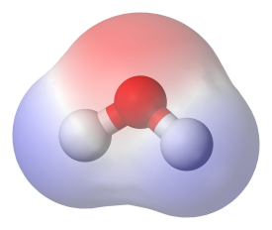
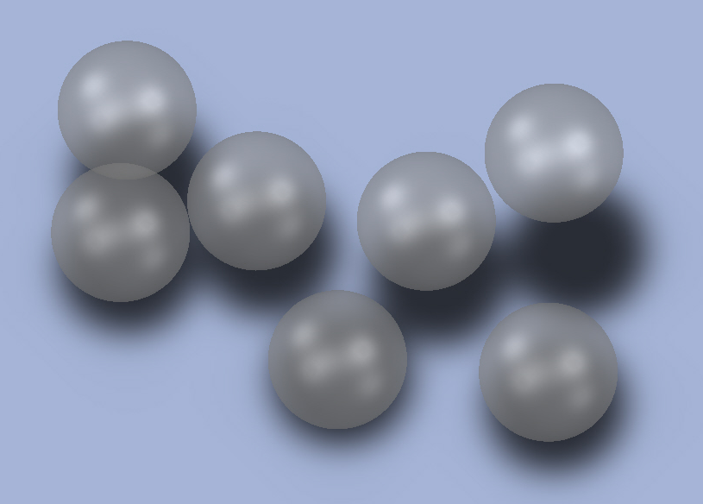
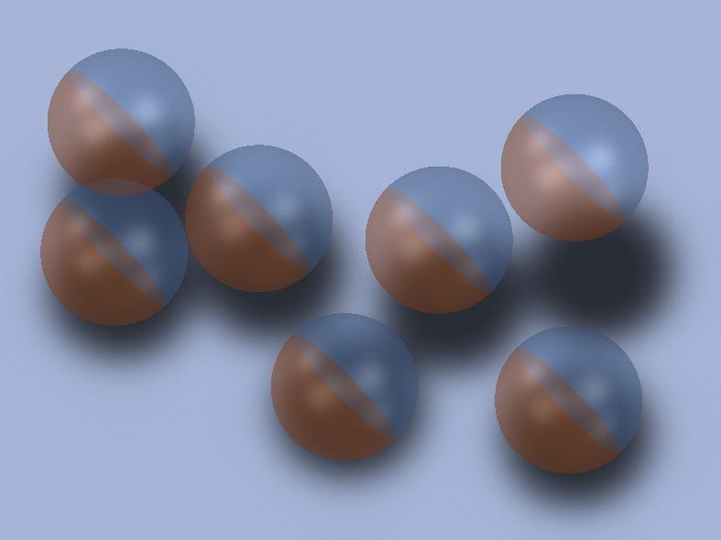
Molecular Model of induced Charge
E
E

Slide 8
Clicker question
A conductor is an extreme case of a dielectric, since if an electric field is applied to a conductor, charges are free to move within the conductor to set up “induced charges”. What is the dielectric constant of a perfect conductor?
K = 0
K =
A value depends on the material of the conductor

