Slide 1
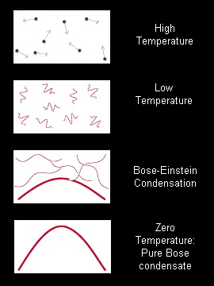
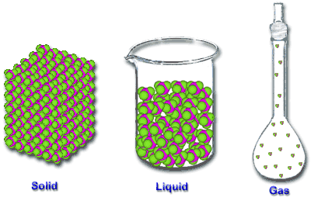
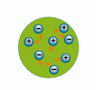
Physics and Chemistry of Solids
Introductory remarks
What characterizes the solid state?
States of matter
Plasma

Slide 2
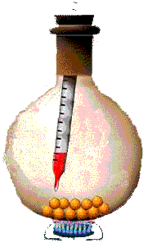
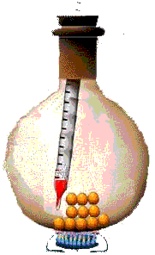
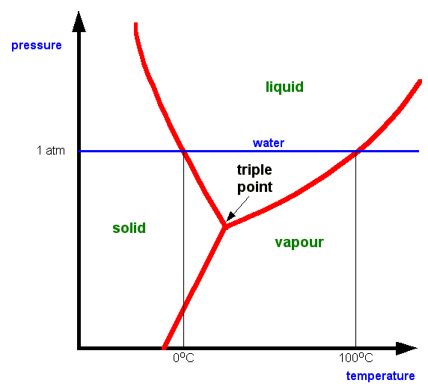
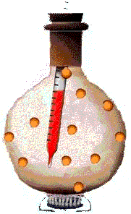
Anomaly of water:
Clausius-Clapeyron
For more info click http://physics.unl.edu/~cbinek/Phase%20transitions.pps

Slide 3
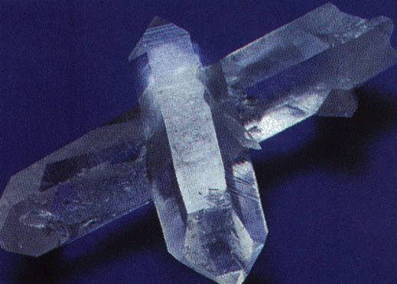
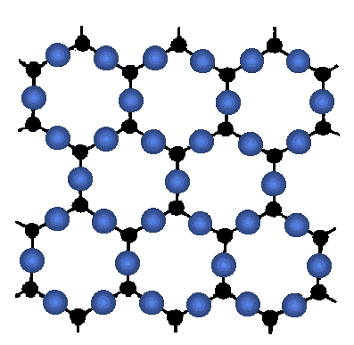
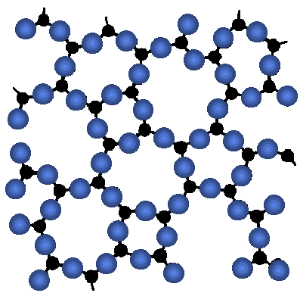
Quartz (SiO₂) crystal
Solids
Crystalline SiO₂
Click for details about quartz
Oxygen atom
amorph
glass
Silicon atom
Looks like “supercooled
Liquid”

Slide 4

Crystalline solid
The problem:
> 10²³ electrons experience Coulomb interaction
Help: symmetry
regularly repeated arrangement of atoms
Quantum Mechanics
Statistical Physics
approximate Solution

Slide 5
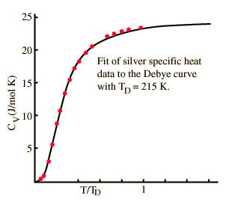
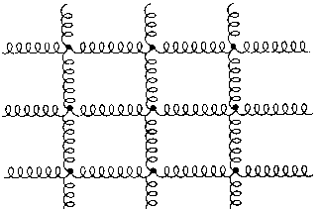
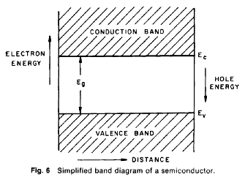
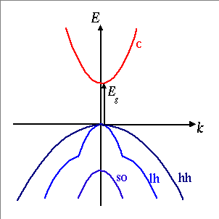
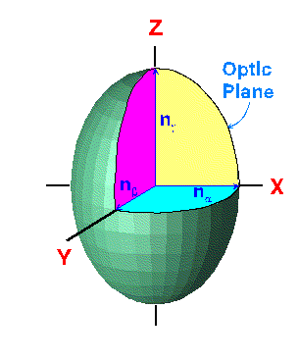
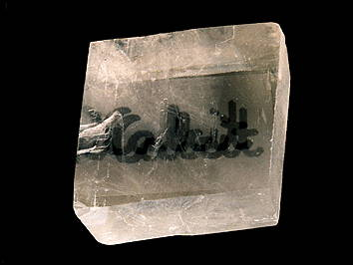
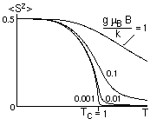
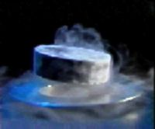
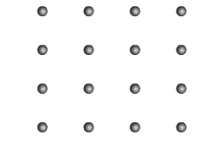
- lattice dynamics, thermal properties
- metals, semiconductors, insulators
- optical and dielectric properties, magnetic properties
Special relativity
- superconductivity

