Slide 1
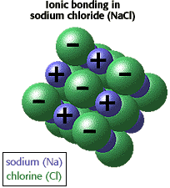
Ionic bond
Ionic Bond
electrostatic interaction of oppositely charged ions
Example: NaCl (sodium chloride)
positive and negative ions arrange by:
Coulomb attraction:
between ions of opposite sign
Coulomb repulsion:
between ions of same sign
Repulsion more than compensated by attraction

Slide 2
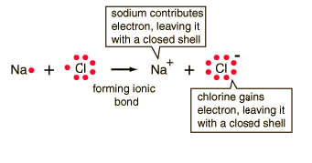
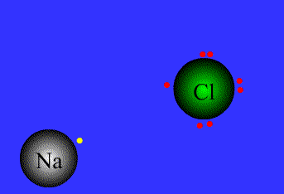
Closer look to energetic
Na⁺
+
+
5.1 eV
(ionization energy)
∞
Cl
Cl⁻
+
+
3.6 eV
(electron affinity)
Na⁺
Cl⁻
Na⁺
Cl⁻
∞
+
+
6.1 eV
(electrostatic energy)
r₀
-0.3 eV (Pauli repulsion)

Slide 3
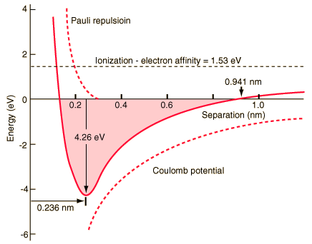
Cl
Na⁺
Cl⁻
4.3 eV=
(6.1-0.3)eV-5.1eV+3.6eV
(dissociation energy)
+
+
r₀
How to find r₀
?
minimum
Click for reference and additional
information

Slide 4
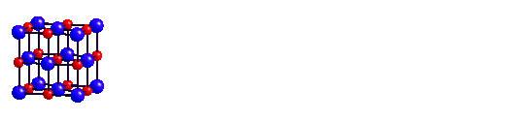
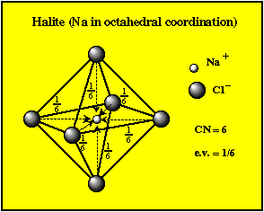
From a single Na⁺Cl⁻ bond to the NaCl solid
r₀
Neither contact between cations (Na⁺ ) nor contact between anions (Cl⁻ )
apart from nearest-neighbor interaction only Coulomb terms involved

Slide 5
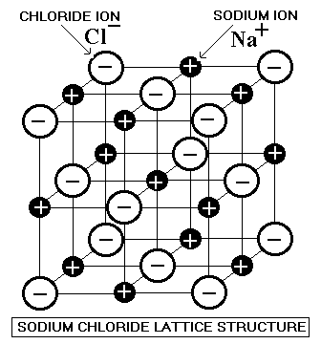
Na⁺ has:
6 Cl⁻ nearest neighbors at distance r₀
12 Na⁺ next nearest neighbors at
8 Cl⁻ further neighbors at distance
r₀

Slide 6
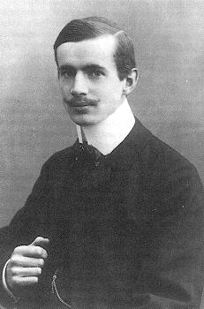
Total Coulomb energy per ion pair: E_{coul}
Madelung Constants
E_{coul}= E( 6 Cl⁻ nearest neighbors at distance r₀ ) + E( 12 Na⁺ nearest neighbors at distance )
+ E( 8 Cl- at distance )+…
Erwin Rudolf Madelung
1881-1972
where α=1.748 is the Madelung constant
Series
slow convergence
methods for accurate sums
Ewald (1921) and Evjen (1932)
alternating sign
Notes:
Madelung Constants
Compound
Crystal Lattice
M
NaClNaCl1.74756CsClCsCl1.76267CaF2Cubic2.51939CdCl2Hexagonal2.244MgF2Tetragonal2.381ZnS (wurtzite)Hexagonal1.64132TiO2 (rutile)Tetragonal2.408bSiO2 Hexagonal2.2197Al2O3Rhombohedral4.1719

Slide 7
Madelung Constants
(Data from Handbook Menu )
Compound | Crystal Lattice | M
NaCl | NaCl | 1.74756
CsCl | CsCl | 1.76267
CaF₂ | Cubic | 2.51939
CdCl₂ | Hexagonal | 2.244
MgF₂ | Tetragonal | 2.381
ZnS (wurtzite) | Hexagonal | 1.64132
TiO₂ (rutile) | Tetragonal | 2.408
βSiO₂ | Hexagonal | 2.2197
Al₂O₃ | Rhombohedral | 4.1719

Slide 8
Total energy per ion pair: E_{i}=E_{Coul}+E_{Repulsive}
unknown parameters
However: condition
r=r₀
determination of,e.g., C

Slide 9
E_{i} @ r=r₀
Input from
experiment
Click here for response functions in gases.
Note that the bulk modulus B is inverse proportional to the bulk compressibility χ
bulk compressibility
since NaCl cubic
corner shared amog 8 adjacent cubes
1/8 (4Na⁺ +4Cl⁻)=1/2 NaCl
1 NaCl-molecule requires
+
r

Slide 10
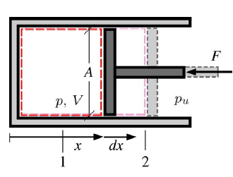
Click for details. Note special sign convention in thermodynamics
work δW=pdV related volume change
Aim:
and
Let´s remember

Slide 11
Cohesive energie
(can be experimentally determined via Born-Haber cycle)
Click for detailed information
Properties of ionic crystals
for all alkali halides
Mott and Gurney 1948
However: widely varying values of C in the repulsive term
?
closed-shell ions behave like incompressible spheres
take into account different radii according
(alkali)⁺
(halogen)⁻
universal C´ for all alkali halides

Slide 12
Ionic Sizes

Slide 13
Completely ionic bond is an ideal case
In general bond neither covalent nore pure ionic
Mixed ionic-covalent bonds
determined from
Min.
Paulings concept of electronegativity
Semi-quantitative estimation of λ
Electronegativity refers to the ability of an atom in a molecule to attract shared electrons.
δ⁺
δ⁻
A
B
A
B
+

Slide 14
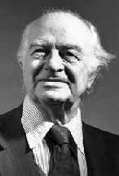
δ⁺
δ⁻
[
1/2
>
]
E( )
E( )
E( )
A
A
B
B
A
B
because there is Coulomb interaction between δ⁺und δ⁻
empirical formula
better than
Linus Pauling
is the only person ever to receive two unshared Nobel Prizes
—for Chemistry (1954) and for Peace (1962).

Slide 15
Find here Pauling’s electronegativity
online

Slide 16
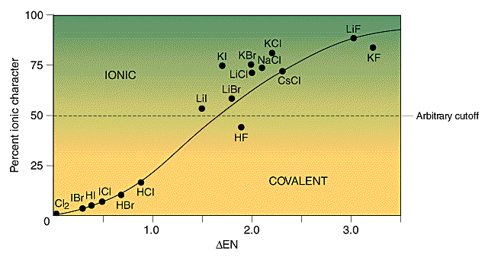
% ionicity of bond
determined from dipole moment of molecules
% ionicity of bond

