Slide 1
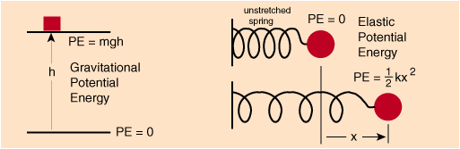

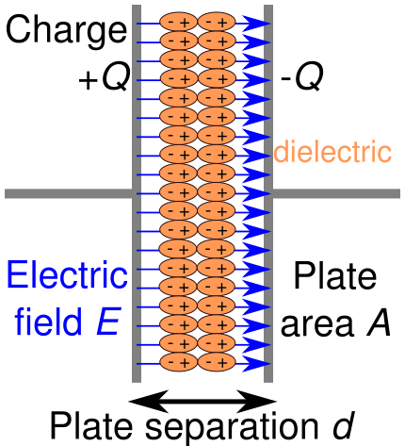
Capacitance and Dielectrics
Capacitors and Capacitance
In mechanics we are used to devices which store potential energy
Is there a way to store electric potential energy
Capacitors

Slide 2
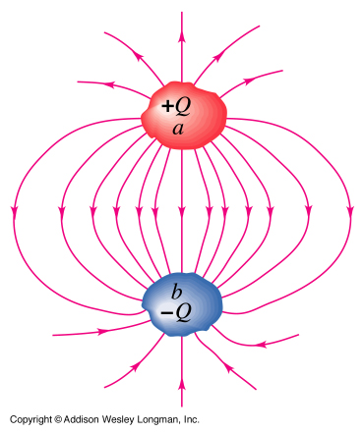
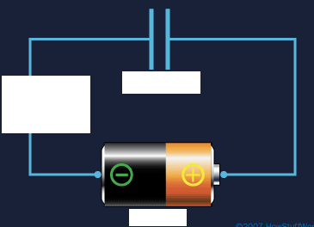
Any 2 conductors insulated from each other form a capacitor
can be realized by an insulating material (dielectric) or vacuum
In circuit diagrams a capacitor is represented by
the symbol:
Let’s charge a capacitor
-Q
+Q
V_{ab}=V_{a}-V_{b}
V_{b}
V_{a}

Slide 3
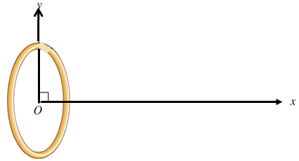
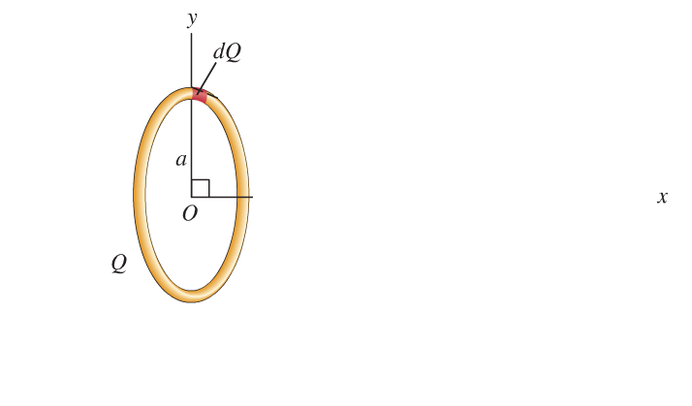
Remember our electric field calculations for various charged objects
We always find
Since
voltage
Capacitance
depends only on geometry and dielectric properties,
not on charge
SI unit 1F=1C/V read F=Farad in honor of Michael Faraday
Capacitance is an intuitive characterization of a capacitor. It tells you:
how much charge a capacitor can hold for a given voltage (potential difference).
The more the higher the capacitance

Slide 4
Calculating capacitance
According to
the major task in calculating C is calculating V_{ab}
Homogeneous field, E=σ/ε₀ for
the limit d<< plate dimensions
Parallel-plate capacitor
-------------------------------------------
Using
Charge density
+++++++++++++++++++++++++
d
We obtain the capacitance C of a parallel-plate capacitor in vacuum as
Note: 1F is a huge capacitance. More typical values are 1µF=10⁻⁶F to 1pF=10⁻¹²F

Slide 5
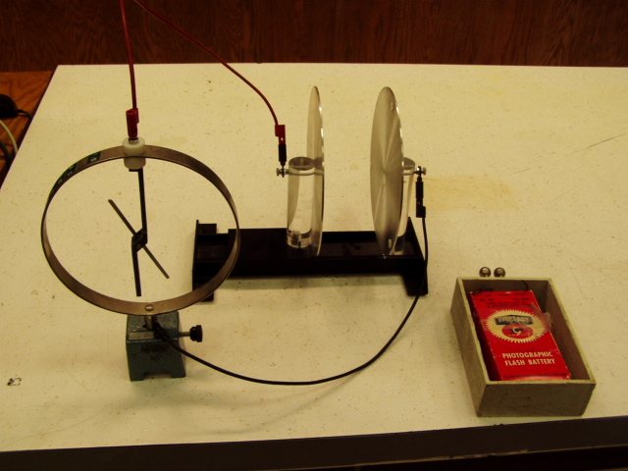
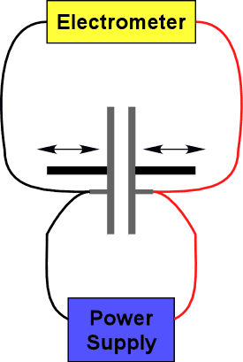
Demonstration: parallel-plate capacitor

Slide 6
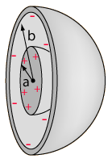
A few slightly more involved examples
Capacitance of a spherical capacitor
Step 1:
calculate the electric field using Gauss’s law between the 2 spheres
for
Image from
http://hyperphysics.phy-astr.gsu.edu/hbase/electric/capsph.html
Step 2: calculate the voltage V_{ab} for a given amount of charge Q on the spheres
Step 3: applying

Slide 7
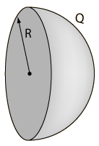
Clicker question
Does an isolated (individual) charged sphere have capacitance?
1) No, where would the electric field lines end?
2) Yes, I just don’t know the value
3) Yes, it is a special case of
in the limit b->∞
Image from
http://hyperphysics.phy-astr.gsu.edu/hbase/electric/capsph.html

Slide 8
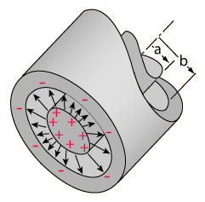
Capacitance per length of a cylindrical capacitor (coaxial cable)
Step 1:
calculate the electric field using Gauss’s law
Cylinder with a<r<b
L
Step 2: calculate the voltage V_{ab}
Step 3: applying
Typical value for antennas, VCRs 69pF/m

Slide 9



Clicker question
How did I like the first midterm exam?
A) I have a thing for midterms, this one rocked as usually*
B) The midterm was hard and unfair.
C) The midterm was as expected
D) I hate exams and this one was particularly bad. Hate it, hate it, hate it.
*

