Slide 1
Energy and power in electric circuits
+
V_{a}
+
V_{b}
I
Circuit element such as
resistor, battery, …
-
For qV_{ab}>0 : charge q looses potential energy., electric force does work on
the charge
Since current is stationary
Charge is not gaining kinetic energy but energy qV_{ab} is transferred into
circuit element, e.g., in the form of heat, light, …
For qV_{ab}<0 : charge q gains potential energy, circuit element is a source of
emf such as a battery
If I is the current flowing through the element
charge passing through
the element in dt

Slide 2
Potential energy of dQ changes by
Change of energy per time is the electric power, e.g., consumed by the circuit element
Unit: 1VA=1JA/As=1J/s=1W
If circuit element is a resistor we obtain
Power delivered to a resistor
If circuit element is a source (of emf)
Rate a which source delivers power
Power dissipated by internal resistance of source
Rate at which work is done on charge by nonelectrostatic (e.g., chemical) force

Slide 3
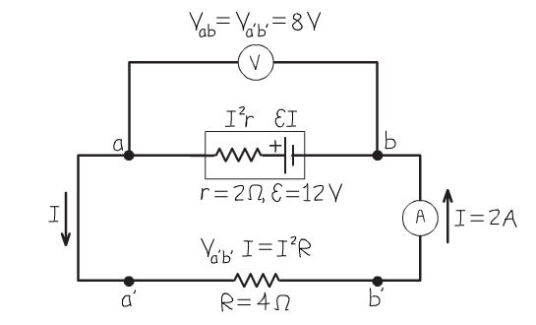
An example:
What is the rate at which the battery converts chemical into electrical energy?
What is the power dissipated by the internal resistance of the battery?
What is the power dissipated by the external resistor R?

Slide 4
Energy conservation (per time):

