Slide 1
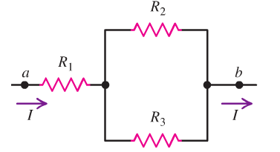
DC circuits and Kirchhoff’s rules
Direct current (dc) circuits are those where the direction of the current is constant
In contrast to alternating current (ac) discussed later
Circuits are in general not as simple as the examples we considered so far
R
but can be far more complex
first step towards more complexity: network of resistors

Slide 2
Resistors in series and parallel
For any combination of resistors we can always find a single resistor replacing the combination resulting in the same I and V
V_{ab}
R_{eq}
V_{ab}
How to find this equivalent resistance systematically
Let’s start with resistors in series
We know:
and I is the same for R_{1,2,3}

Slide 3
With
and
here
This can be generalized to any number of resistors
using R_{eq}(n+1)=R_{eq}(n)+R(n+1) and R_{eq}(1)=R₁
into
for resistors in series

Slide 4
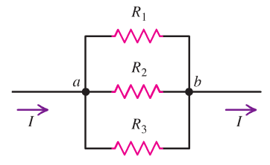
Resistors in parallel
The major step towards a rule for the equivalent resistance for the parallel circuit is to realize:
i) Voltages across all R_{1,2,3} are identical
ii) Current I splits into currents I_{1,2,3} such that I=I₁+I₂+I₃
This again can be generalized to any number of resistors
for resistors in parallel

Slide 5
Clicker question
To switch off the electric candles decorating the Xmas tree of my friends
in good old Germany, they can remove just one candle out of its socket. This lazy trick works because
1) The electric candles are connected in parallel
2) The electric candles are connected in series
3) There is no relation to what we just learned. Light bulbs are no
resistors. The trick works
because of Santa.

