Slide 1
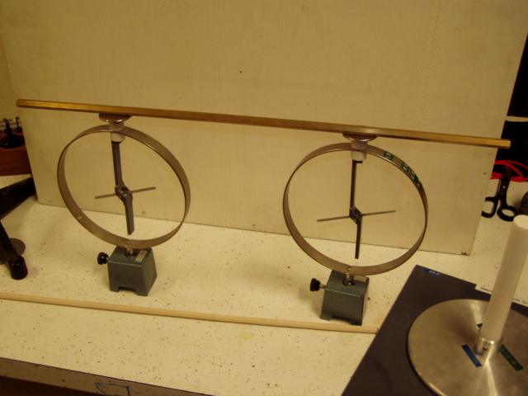
Conductors, insulators and induces charges
Conductors, insulators
We show experimentally that there are :
materials which allow to move charge from one region to another
Conductors
Materials which don’t allow to move charge from one region to another
Insulators
Experiment :

Slide 2
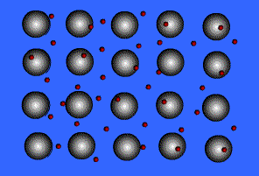

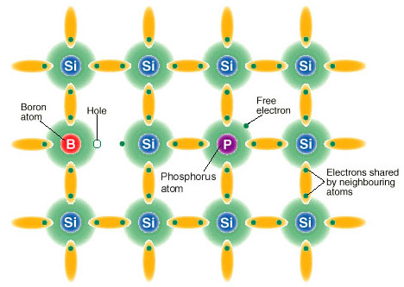
An intuitive reason why metals are good conductors
e.g.
Li⁺
e⁻
SEA OF MOBILE VALENCE ELECTRONS
In semiconductors and insulators
electrons are localized in directed
chemical bonds

Slide 3

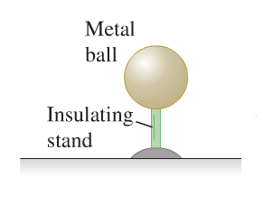

Induced charges
Let’s consider two distinct ways to charge a metal sphere:
1) Using conduction
-
-
-
-
-
-
-
-
-
-
-
2) Using Induction
+
-
+
-
-
-
-
+
-
-
+
-
-
-
+
-
-
-
-
-
-

Slide 4
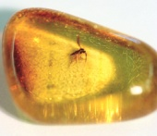

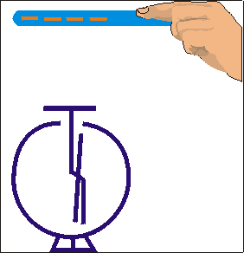
Induction of charge explains a couple of observations
Lets reconsider the amber and paper piece experiment
-
-
+
-
-
-
-F
F
+
-
-
-
-
+
+
-
Pair of forces according to Newton’s third law

Slide 5

Clicker question
Two identical conducting spheres have charges of 2µC and 3µC
2µC
3µC
They are brought into contact without charge leaking out into the environment
If the spheres are then separated again, the distribution of charge on the spheres will be:
1)
3µC
2µC
2)
2.5µC
2.5µC
3)
0µC
5µC
4)
5µC
5µC

