Slide 1
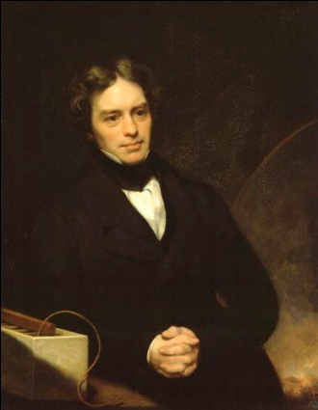
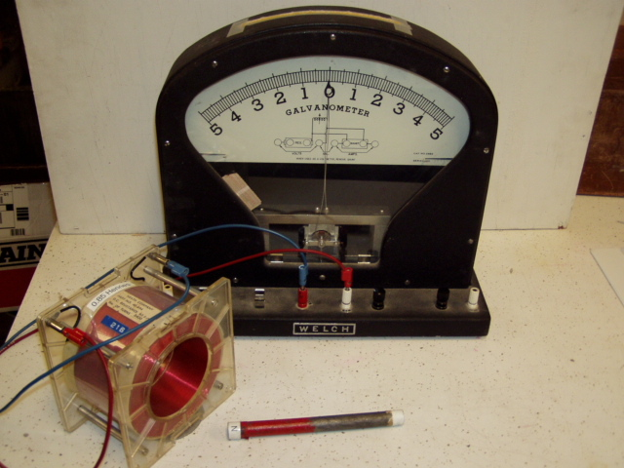
Electromagnetic Induction
We address now the question: what is the physics behind electric power
generation?
Let’s follow the experimental path to Faraday’s law
http://en.wikipedia.org/wiki/File:Michael_Faraday_001.jpg

Slide 2
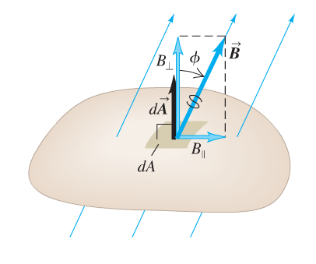
Faraday’s law:
Central element of Faraday’s law is the magnetic flux we introduced before
magnetic flux
through surface
vector field
surface
Why the minus sign?
Faraday’s law of induction:
the induced emf in a closed loop equals the negative time derivative of the magnetic flux through the loop

Slide 3
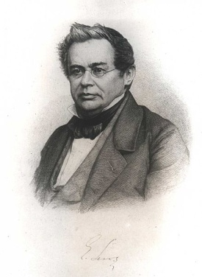
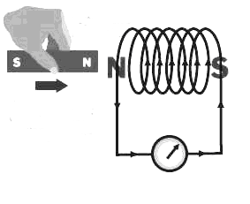
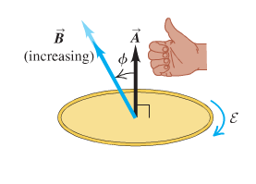
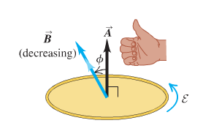
Lenz rule: An induced current is always in such a direction as to oppose the motion or change causing it (consequence of energy conservation)
http://en.wikipedia.org/wiki/Heinrich_Lenz
A force is needed to move the permanent magnet
This force does work allowing to induce the current
This current will be dissipated and transferred into heat
Energy conservation
Lenz rule is the physical reason for the right hand rule used in the text book
Curl fingers around A
induced emf and resulting current negative
induced emf and resulting current positive

Slide 4
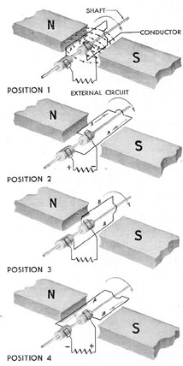
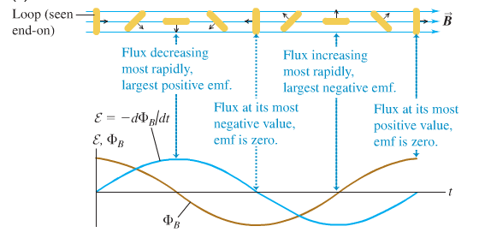
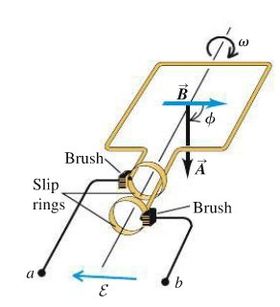
As an example of Faraday’s law lets consider a simple alternator
Flux is at maximum
Flux is zero
Flux changed sign to negative
Flux is zero again

Slide 5
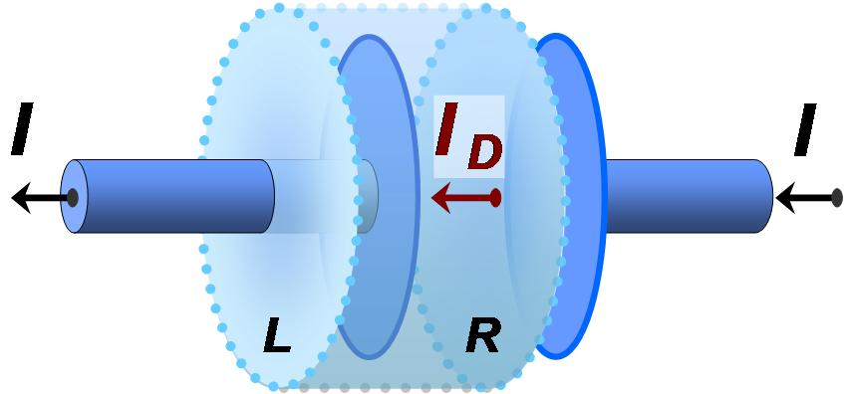
Displacement Current
We are getting closer to be able to write down the set of Maxwell’s equations
However: we are missing one more conceptual step
Completion of Ampere’s law by displacement current
Consider charging of a plate capacitor
How can the same current flow out the wire that flows in when there is no charge current flowing in the vacuum between the capacitor plates?

Slide 6
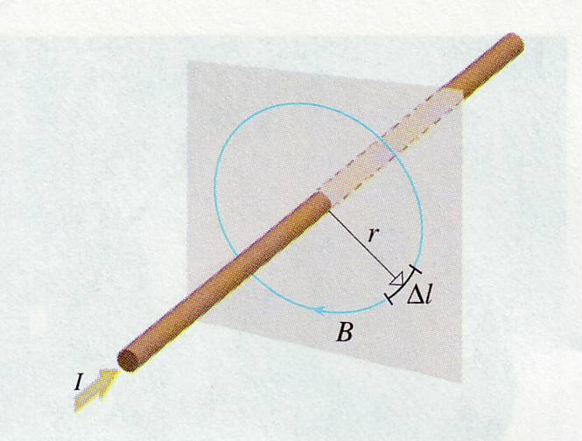
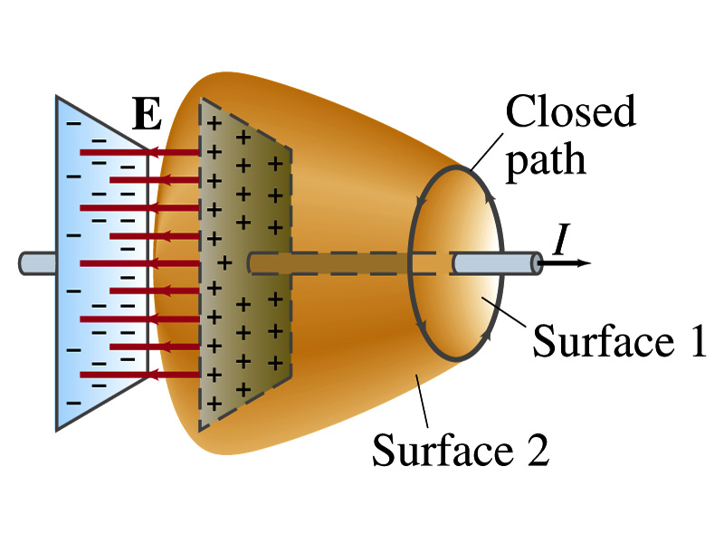
Let’s apply Ampere’s law (as we introduced it previously)
$$\oint{\underline{B}} d\underline{r}=μ_{0}I_{encl}$$
Ampere’s law
In this form Ampere’s law is incomplete
Let’s apply Ampere’s law for the path enclosing surface 1
$$\oint{\underline{B}} d\underline{r}=μ_{0}I_{encl}=μ_{0}i_{C}$$
charge current
However, the same path encloses surface 2 that bulges out.
The charge current through surface 2 is zero

Slide 7
Maxwell’s generalization of Ampere’s law
Consider the plate capacitor on charging
Charge of plate at a given moment in time:
$$q=CV$$
$$=\frac{εA}{d}V$$
$$=\frac{ε_{}A}{d}Ed$$
$$=ε_{} AE$$
Electric flux
$$Φ_{E}$$
With q=q(t) we can introduce a current
$$\frac{dq}{dt}= i_{D}=ε\frac{dΦ_{E}}{dt}$$
where i_{D} is called the displacement current
$$\oint{\underline{B}} d\underline{r}=μ_{0}{\left(I_{C}+I_{D}\right)}_{encl}$$
Generalized Ampere’s law

Slide 8
Clicker question
Does the displacement current have physical relevance in the sense that the displacement current between the plates of a capacitor on charging creates a magnetic field
A) No, there are no electric charges flowing between the plates therefore there is no current and therefore there is no magnetic field
B) The generalized Ampere law says that the displacement current will generate a magnetic field in the same way a charge current does
C) There will be a B-field, but it will be smaller in magnitude than the B-field creates by a comparable charge current

Slide 9
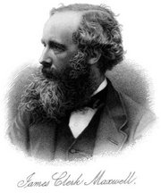
James Clerk Maxwell (1831-1879)
Born in Edinburgh, Scotland
Physicist well-known for his work in electromagnetism and field theory
Also known for his work in thermodynamics and kinetic theory of gases
http://en.wikipedia.org/wiki/James_Clerk_Maxwell

Slide 10
Maxwell’s Equations
The two Gauss’s laws are symmetrical, apart from the absence of the term for magnetic monopoles in Gauss’s law for magnetism
Faraday’s law and the Ampere-Maxwell law are symmetrical in that the line integrals of E and B around a closed path are related to the rate of change of the respective fluxes

Slide 11
Gauss’s law (electrical):
The total electric flux through any closed surface equals the net charge inside that surface divided by ε_{o}
This relates an electric field to the charge distribution that creates it
Gauss’s law (magnetism):
The total magnetic flux through any closed surface is zero
This says the number of field lines that enter a closed volume must equal the number that leave that volume
This implies the magnetic field lines cannot begin or end at any point
Isolated magnetic monopoles have not been observed in nature

Slide 12
Faraday’s law of Induction:
This describes the creation of an electric field by a changing magnetic flux
The law states that the emf, which is the line integral of the electric field around any closed path, equals the rate of change of the magnetic flux through any surface bounded by that path
One consequence is the current induced in a conducting loop placed in a time-varying B
The Ampere-Maxwell law is a generalization of Ampere’s law
It describes the creation of a magnetic field by a changing electric flux and electric charge currents

