Slide 1
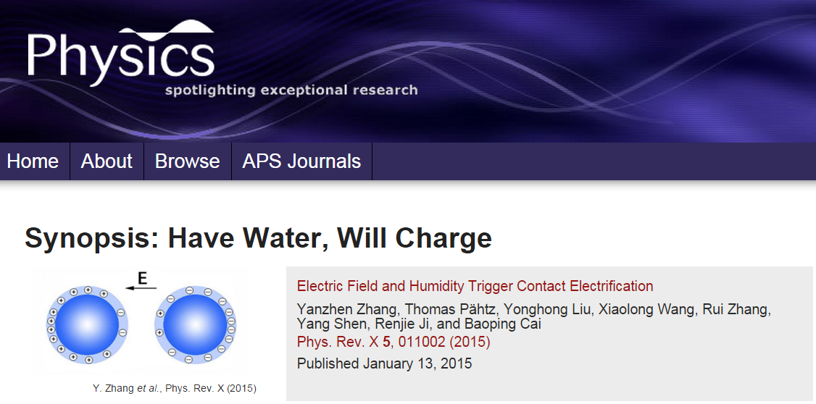
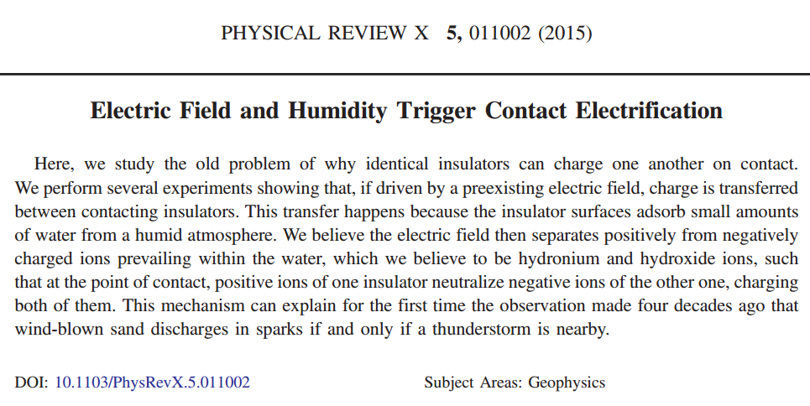
Modern research on Contact Electrification
Get spotlight
article here
Get PRX here

Slide 2
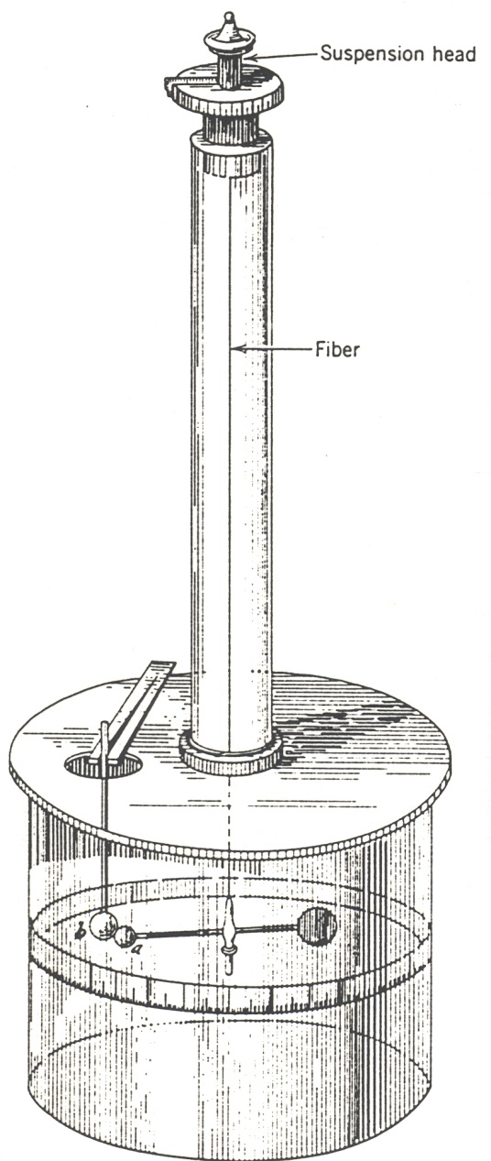
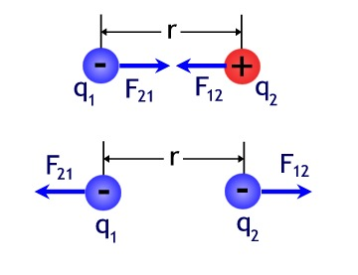
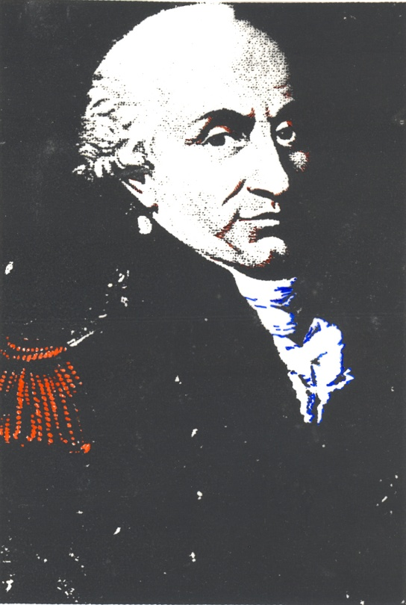
Coulomb’s law
Experiments by Charles Coulomb with a torsion balance reveal
Charles Coulomb (1738-1806)
In words:
The magnitude of the electric force between two point charges is
directly proportional to the product of the charges and inversely
proportional to the square of the distance between them.
http://www.youtube.com/watch?v=FYSTGX-F1GM

Slide 3
The experimentally established proportionalities summarized in one compact expression
Magnitude of the forces that each of the two
point charge distance r apart exerts on the other
In SI units the constant k is expressed as
With the vacuum permittivity
1C=1Coulomb is the unit of charge
Since the modern definition of the unit of charge originates from current measurement
we use today As instead of C
Charge of an electron:
This is a value of a constant you want to memorize

Slide 4
A few remarks about the Coulomb force
1C=1As is a huge amount of charge we typically do not encounter
Typical values are in the range µC to nC
Clicker question
To see why let’s spend some time on this clicker question:
Suppose there are two point charges of 1C each separated by 1m
What is the magnitude of the forces between them?
A) 2 X 10¹² N
B) 9 X 10⁹ N
C) 30 N
D) 5000 N

Slide 5
Obvious similarity between Coulomb force and gravitational force
We see later more clearly: Similar structure not by chance
Charge: source of electric field Mass: source of gravitational field
Significant differences:
Charges can be positive and negative there is no negative mass
Coulomb forces can be attractive and repulsive Gravity only attractive
Gravity is extremely weak (typically 35 orders of magnitude weaker) in comparison with Coulomb force

