Slide 1
Clicker question
Do you have access to MasteringPhysics
A) Yes
B) No
C) No, but I am confident
to get it from the bookstore
before Thursday January 23

Slide 2
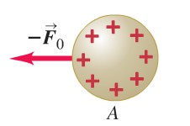
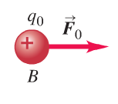
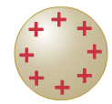
Electric field and forces
Let’s reconsider Coulomb interaction
We know already
We ask:
How does particle B know that A is there to exert a force
and vice versa
Answer:
The presence of charge A alters the empty space and charge
B experiences this alteration we call electric field
Point P

Slide 3
Point P
A test charge q₀ at point P experiences the force
The concept of probing the electric field by the force experienced by a test charge gives rise to the definition:
The electric field E at a given point is given by the force F₀ experienced by the test charge q₀ divided by q₀
The limit makes sure that the test charge does not affect the surrounding charge distribution

Slide 4
From
we realize that the electric field is a vector quantity
Vector properties of E originate from vector properties of F ₀
Let’s first have a closer look to the vector properties of the Coulomb force
q₀
F ₀
points in the direction
of
q
When writing:
z
where $r=\left|Δ\underline{r}\right|$and
y
is a unit vector pointing
in direction of
Everything is taken care of, including the various signs
of both charges
x

Slide 5
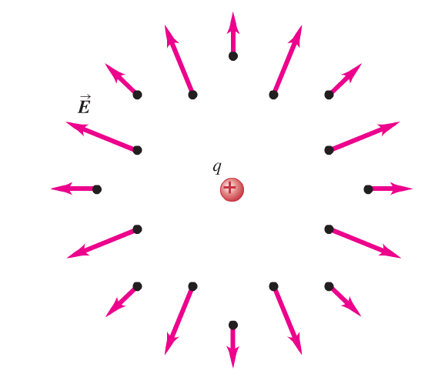
With the full vector information about the force F₀ the test charge experiences in an electric field of a point charge q we can visualize the vector character of the E-field of a point charge
E-field of a positive point charge:
q₀
+q
q₀
z
y
x

Slide 6
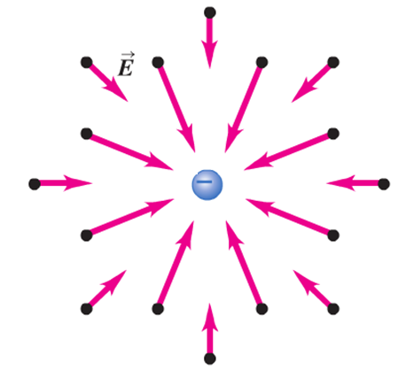
E-field of a negative point charge:
-q
is mathematically speaking a vector field
-Remember: for a 1-dimensional function we assign to every x a value f(x)
-for a vector field in 3d we assign to every point in 3d space
a vector
If
independent of (x,y,z) we say the field is homogeneous
A special case is the zero electric field inside a conductor
Electrostatic fields must be zero here because otherwise they would drive a current

Slide 7
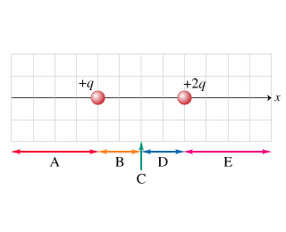
Clicker question
For the charge distribution shown in the figure indicate a region where a point exists at which the net electric field is zero
A) Region A
B) Region B
C) Point C
D) Region D
E) Region E

