Slide 1
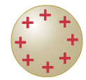
Electric dipoles
An electric dipole is a pair of point charges with equal magnitude & opposite sign
-
-
-
-
-
+q
d
-
-q
-
-
We investigate the dipole properties for various reasons:
-as an important example for the concept of superposition of electric fields
and the concept of field lines
-as a preparation for the discussion of antenna, polar molecules, dielectrics, …
-to apply the concepts of force, torque and potential energy

Slide 2
Field of an electric dipole
The total electric field E(r) is given by the superposition E(r)= E₁(r) + E₂(r)
Let’s explore a few points graphically
Analytically in the x-y-plane:
Y
Special case x=0:
q₁=+q
X
q₂=-q
Special case y=0:

Slide 3
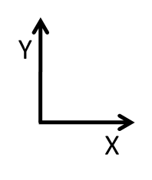
If we know electric field in coordinate system S
how do we express it in coordinate system S’
To answer this question we have to look at the description of
the position vector r in the two coordinate systems
S’
r’ =(x’,y’)
Y’
r =(x,y)
S
X’
d
r=d+r’
E ( r’ ) =E ( r-d )

Slide 4
Let’s apply this transformation scheme to the electric field of a point charge
S
$$\underline{E}\left({\underline{r}}^{′}\right)=\frac{1}{4πε_{0}}\frac{q}{{r^{′}}^{2}}\hat{\underline{r′}}$$
S’
Y’
Expressed in coordinates
$$\underline{E}\left({\underline{r}}^{′}\right)=\left(\begin{matrix}E_{x^{′}}(x^{′},y^{′}z′) \\ E_{y^{′}}(x^{′},y^{′}z′) \\ E_{z^{′}}(x^{′},y^{′}z′)\end{matrix}\right)$$
X’
d=(d,0,0)
=$\frac{1}{4πε_{0}}\frac{q}{\left(x^{′2}+{y^{′}}^{2}+{z^{′}}^{2}\right)}\hat{\underline{r′}}$
Using
$\hat{\underline{r′}}$= $\frac{\underline{r}′}{r′}$ =$\frac{1}{\sqrt{x^{′2}+{y^{′}}^{2}+{z^{′}}^{2}}}\left(\begin{matrix}x^{′} \\ y^{′} \\ z′\end{matrix}\right)$
r’=r-d
$$\underline{E}\left({\underline{r}}^{′}\right)=\frac{1}{4πε_{0}}\frac{q}{{\left(x^{′2}+{y^{′}}^{2}+{z^{′}}^{2}\right)}^{\frac{3}{2}}}\left(\begin{matrix}x^{′} \\ y^{′} \\ z′\end{matrix}\right)$$
$$\underline{E}\left(\text{r}\right)=\frac{1}{4πε_{0}}\frac{q}{{\left({(x−d)}^{2}+y^{2}+z^{2}\right)}^{\frac{3}{2}}}\left(\begin{matrix}x−d \\ y \\ z\end{matrix}\right)$$

Slide 5
As an exercise with relevant application let’s explore an approximate
expression of the electric dipole-field on the x-axis for x>>d
Y
(x,y=0)
X
q₁=+q
q₂=-q
d
We inspect the x-component of
neglecting quadratic terms in d since x>>d
We define the electric dipole moment
for the case $\sum{q_{i}}=0$
which here has only a x-component

Slide 6
Electric field lines
Vector fields such as the E-field are somewhat abstract and hard to picture
The concept of field lines can help us out
E-field
In this point
field line
Properties of field lines:
Imaginary curve such that tangent at any point is along the E-field in this point
density of field lines in a given region allows to picture the magnitude of the E-field
At any particular point in space the E-field has a well defined direction
Only one field line can pass through each point
Field lines never cross

Slide 7
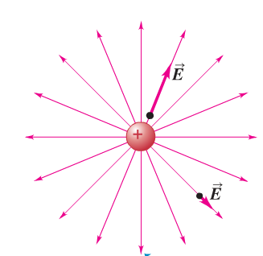
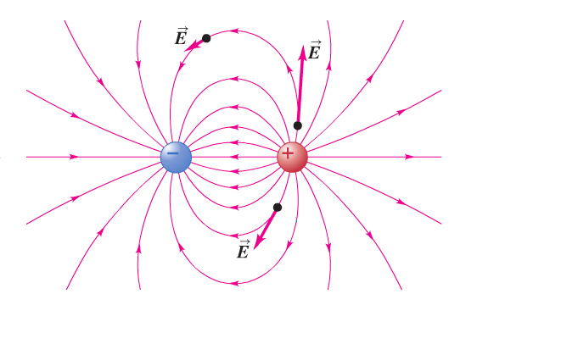
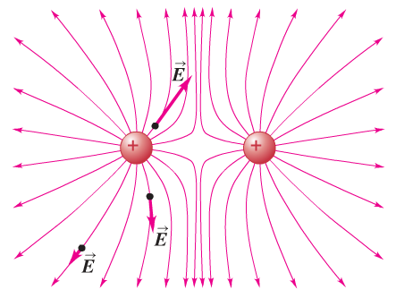
Some examples
Like the E-field, field lines point away from positive charges
Closer to the charge, where E-field is stronger, higher density of field lines meaning more lines per volume
E-field vector tangent to field lines
Positive point charge
Same properties can be found in other examples
dipole
Two equal positive charges

Slide 8
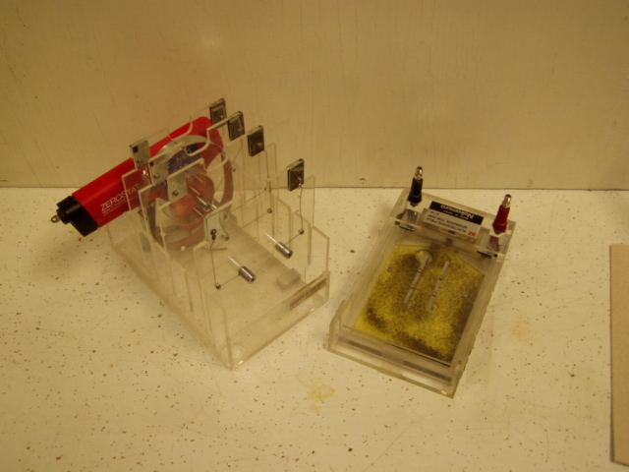
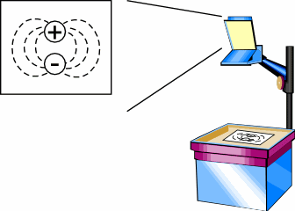
Visualizing electric field lines
Demonstration5B10.40

Slide 9
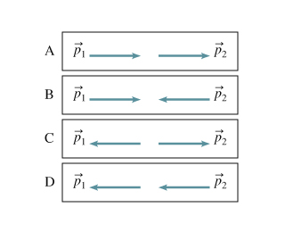
Clicker question
The figure shows four possible arrangements of two identical electric dipoles with dipole moment p₁ and p_{2.} For which arrangement(s) are the 2 dipoles attracted to each other
1=A on clicker) A
2=B on clicker) B and C
3=C on clicker) C
4=D on clicker) A and D
8=E on clicker) B and C

Slide 10
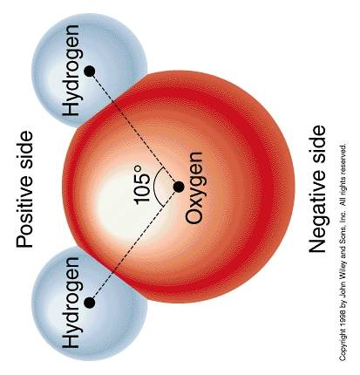
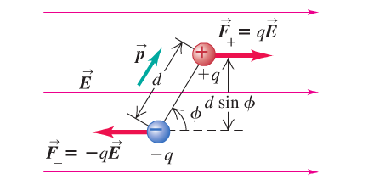
Water is a polar molecule that in good approximation is described as a dipole
p
Our definition of the electric dipole moment
ensures that p is directed
from the negative end to the positive
Force and Torque on an Electric Dipole
Total force:
Torque:
Field lines of a
homogeneous E-field

Slide 11
Torque on an electric dipole in a field
with
Potential energy of an electric dipole in an electric field
Let’s calculate the work done by the electric field on the dipole on rotation
From:
Takes into account dφ<0
With
Potential energy U of a dipole in E-field

