Slide 1
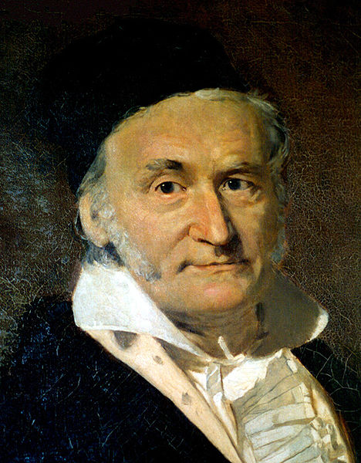

Application of Gauss’s law
Charge distribution given
Electric field
Charge distribution
Electric field given
We conclude
Gauss rocks
Carl Friedrich Gauss (1777–1855)

Slide 2
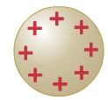

Let’s practice some examples first for the case
Charge distribution given
Electric field
1
Electric field outside the sphere
R
We almost solved this problem before
Use the symmetry of charge distribution
good idea to use a Gauss sphere
Positive charge Q on a conducting sphere of radius R
charge will be on the surface of the sphere, inside the sphere no charge
with E normal to surface of Gauss
sphere and constant on surface
r
with r > R
r is a running variable because we can apply the calculation for any r>R

Slide 3
2
Electric field inside the sphere
Gauss sphere with r<R
no net charge inside the Gauss sphere
R
r
r
with r < R
consistent with

Slide 4


What changes if the sphere is insulating and homogeneously charged
Homogeneously charged sphere with charge density
r > R
1
Electric field outside the sphere
+
We see the same enclosed net charge
+
+
+
+
+
+
+
+
+
+
+
+
R
+
+
+
+
+
+
+
+
+
r
+
r<R
+
+
+
+
+
+
+
+
+
+
+
+
+
+
with r > R
+
+
+
+
However
for r < R we now enclose r-dependent net charge
charge enclosed by Gauss sphere of r<R
r
with r < R

Slide 5
Let’s revisit a question we answered before now using Gauss’s law as new tool
Electric field between oppositely charged large parallel plates
-------------------------------------------------
homogeneity of the field
is our input from symmetry
Charge density
+++++++++++++++++++++++++++++++
R
We use a cylinder as a Gaussian surface. This is just one choice out of many possible
no contribution from
the side or bottom
That was easy, thank you Carl Friederich

Slide 6
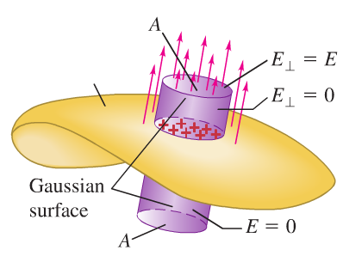
Obviously our choice of the Gaussian surface was arbitrary
For example a box would work as good as the cylinder did
a
b
Field lines at the surface of a charged conductor
are always perpendicular to the surface
(otherwise an in-plane component would move the charges)
We can transfer above considerations to derive the general result for the electric field on an arbitrarily shaped conducting surface
conducting surface
with charge density σ
indicates that on the conducting
surface E is perpendicular

Slide 7
Clicker question
Considering the two situation depicted in the figures. What can you say about the relation between the flux through the surfaces for the left and the right figure?
Assume that a “+” represents the charge of a proton and a “-” represents the charge of an electron.
The surface area of the sphere is twice the surface area of the cylinder.
++
+++
-
+
+
++
+
- +
-
++
-
+
A) The flux through the sphere is twice the flux through the cylinder
B) I need to calculate the flux integral over both surfaces to decide
C) The flux is identical
D) The flux is zero in both cases
E) The flux sucks

