Slide 1
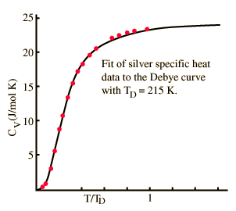
Atomic Vibrations in Solids: phonons
Goal: understanding the temperature dependence of the lattice contribution to the
heat capacity C_{V}
concept of the harmonic solid
Photons* and Planck’s black body radiation law
vibrational modes quantized
phonons with properties in close analogy to photons

Slide 2
The harmonic approximation
Consider the interaction potential
Let’s perform a Taylor series expansion around the equilibrium positions:
when introducing
force constant matrix
Since
and
real and symmetric
We can find an orthogonal matrix which diagonalizes
such that
where

Slide 3
With normal coordinates
we diagonalize the quadratic form
From

Slide 4
Hamiltonian in harmonic approximation can always be transformed into
diagonal structure
harmonic oscillator problem with energy eigenvalues
problem in complete analogy to the photon gas in a cavity

Slide 5
With
up to this point no difference to the photon gas
Difference appears when executing the j-sum over the phonon modes
by taking into account phonon dispersion relation
The Einstein model
In the Einstein model
for all oscillators
zero point energy

Slide 6
Heat capacity:
Classical limit
1 for
for

Slide 7
good news: Einstein model
explains decrease of C_{v} for T->0
bad news: Experiments
show
for T->0
Assumption that all modes have the same frequency
unrealistic
refinement

Slide 8
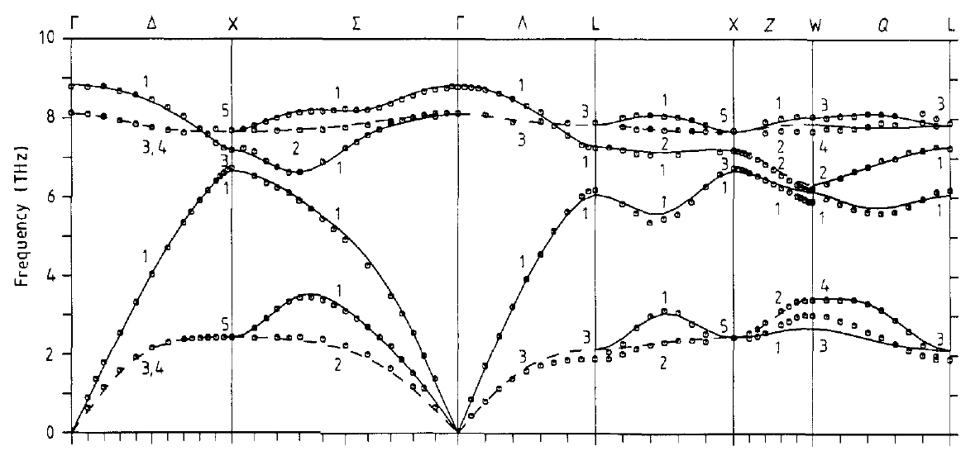
The Debye model
Some facts about phonon dispersion relations:
For details see solid state physics lecture
1)
2)
wave vector k labels particular phonon mode
3)
total # of modes = # of translational degrees of freedom
3Nmodes in 3 dimensions
N modes in 1 dimension
Example: Phonon dispersion of GaAs
k
for selected high symmetry directions
data from D. Strauch and B. Dorner, J. Phys.: Condens. Matter 2 ,1457,(1990)

Slide 9
We evaluate the sum in the general result
via an integration using the concept of density of states:
# of modes in
temperature independent
zero point energy
Energy of a mode
= phonon energy
# of excited phonons

Slide 10
In contrast to photons here finite # of modes=3N
total # of phonon modes
In a 3D crystal
Let us consider dispersion of elastic isotropic medium
Particular branch i:
v_{L}
v_{T,1}=v_{T,2}=v_{T}
here

Slide 11
Taking into account all 3 acoustic branches
?
How to determine the cutoff frequency ω_{max}
D(ω)
Density of states of Cu
determined from neutron scattering
also called Debye frequency ω_{D}
choose ω_{D} such that both curves
enclose the same area

Slide 12
⎛
∂
U
⎞
with
C
v
=
⎜
⎟
⎝
∂
T
⎠
v
Let’s define the Debye temperature
energy
temperature
Substitution:

Slide 13
Discussion of:
Application of Debye theory for
various metals with single fit
parameter θ_{D}

